Slide 1
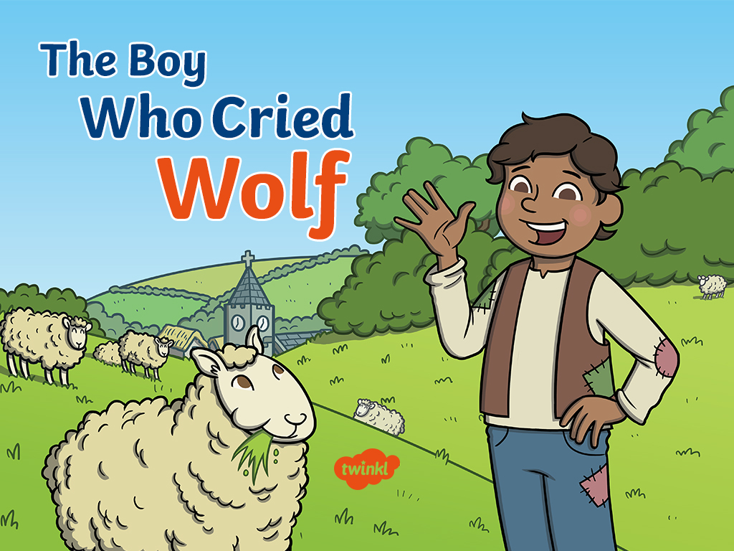

Slide 2
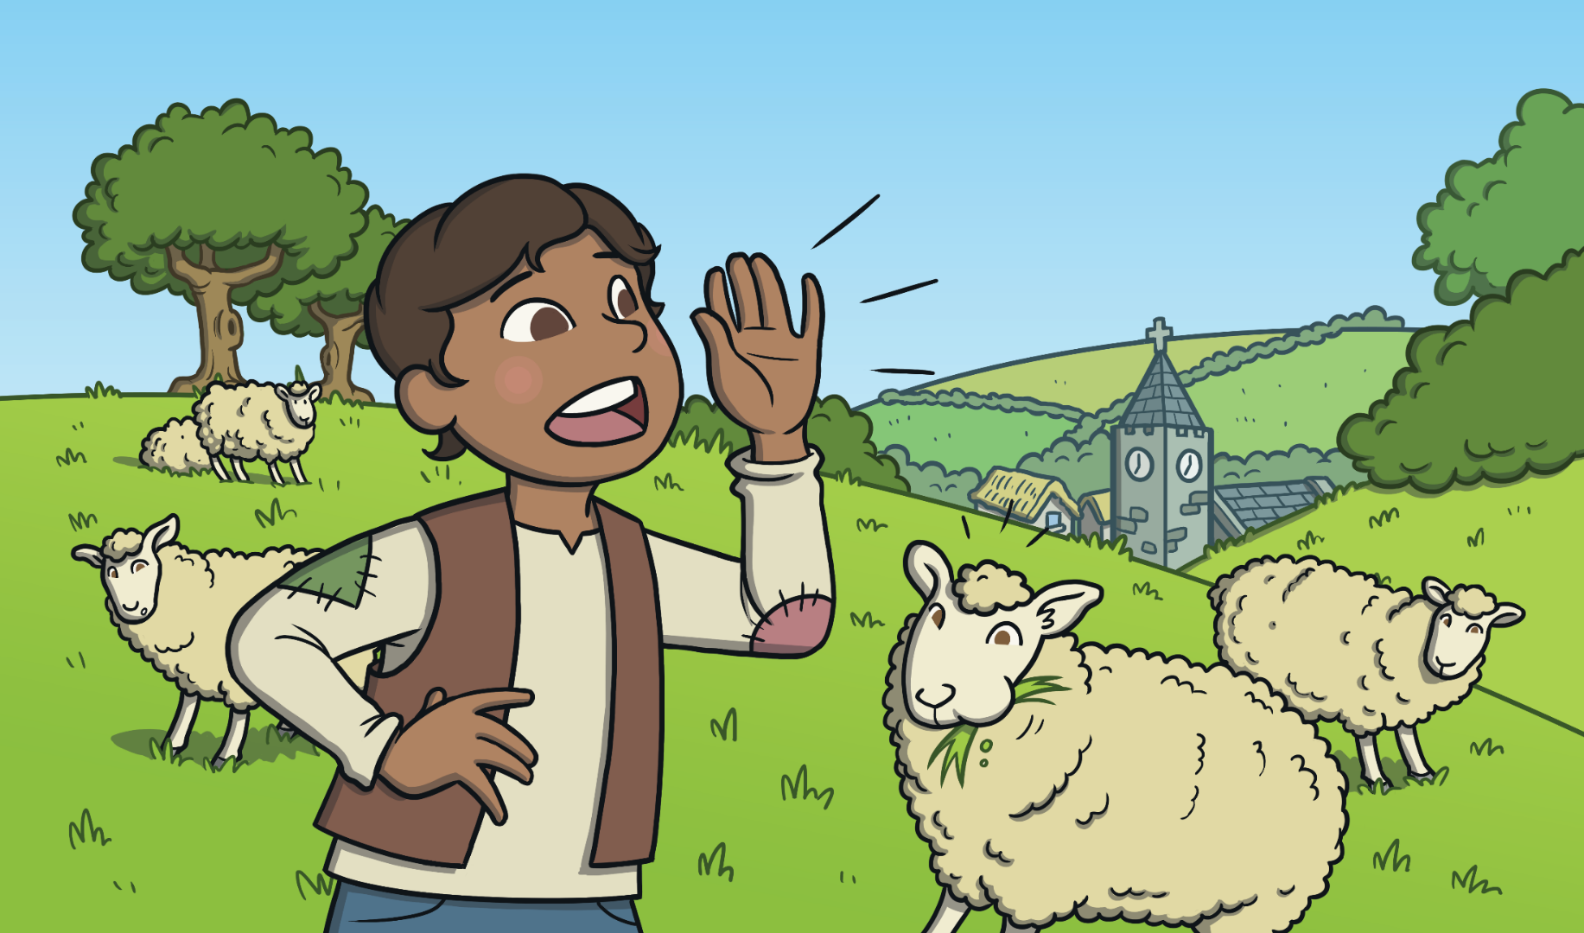
There was once a boy who looked after sheep. The boy was bored. One day, he played a trick on the villagers. The boy cried out that there was a wolf attacking his sheep, even though there wasn’t.

Slide 3
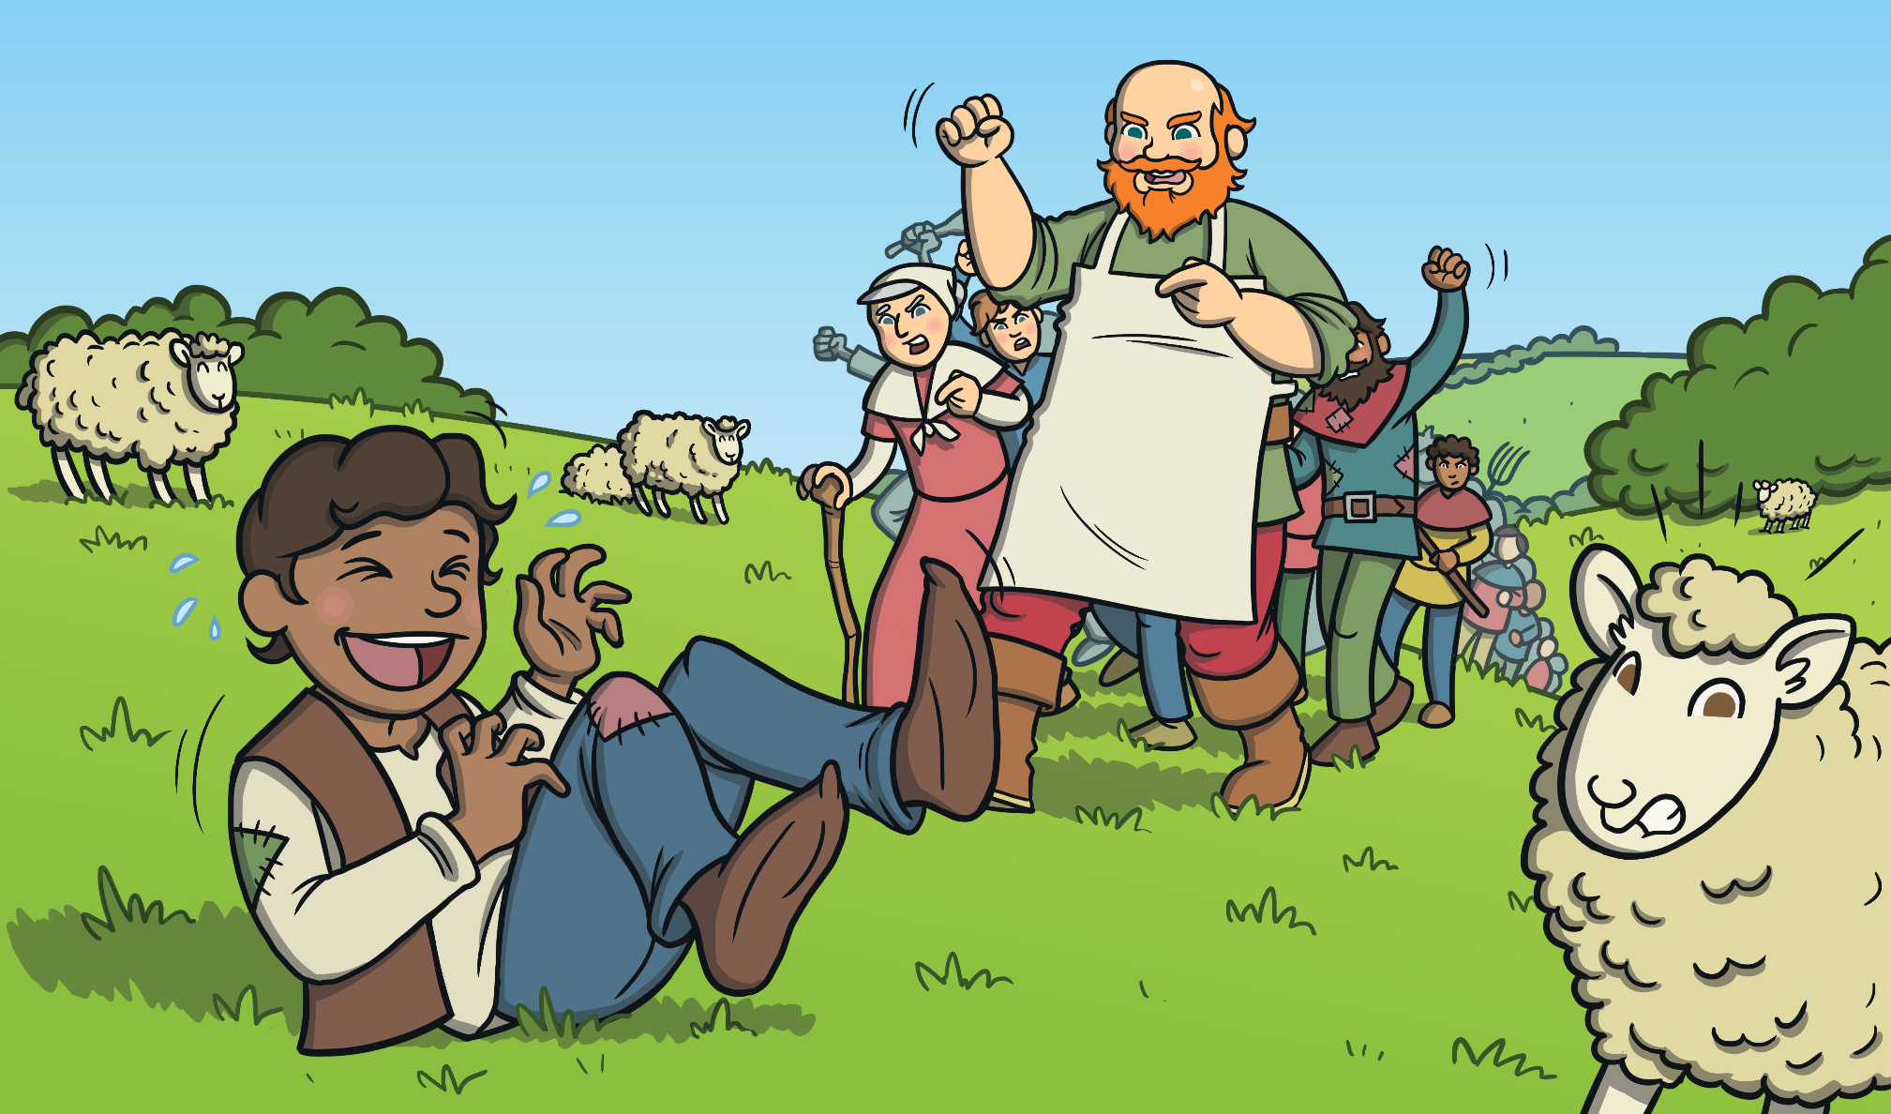
The villagers came up the hill to save the sheep. When they got there, there was no wolf. The boy laughed at them. “You must not tell lies!” said the villagers. They went back to the village.

Slide 4
Soon the boy was bored again. He shouted, “Wolf! Wolf!” The villagers rushed up the hill to save the sheep. When they got there, there was no wolf again. The boy laughed at them again.

Slide 5
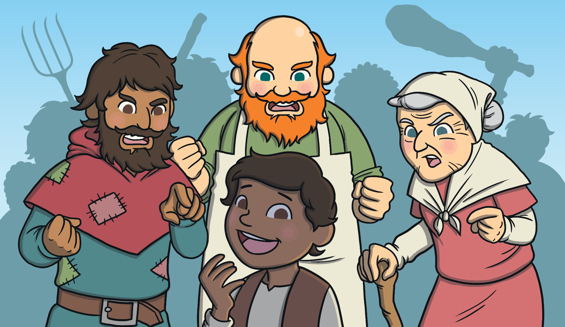
“You must not tell lies!” shouted the villagers. They went back down to
the village.

Slide 6
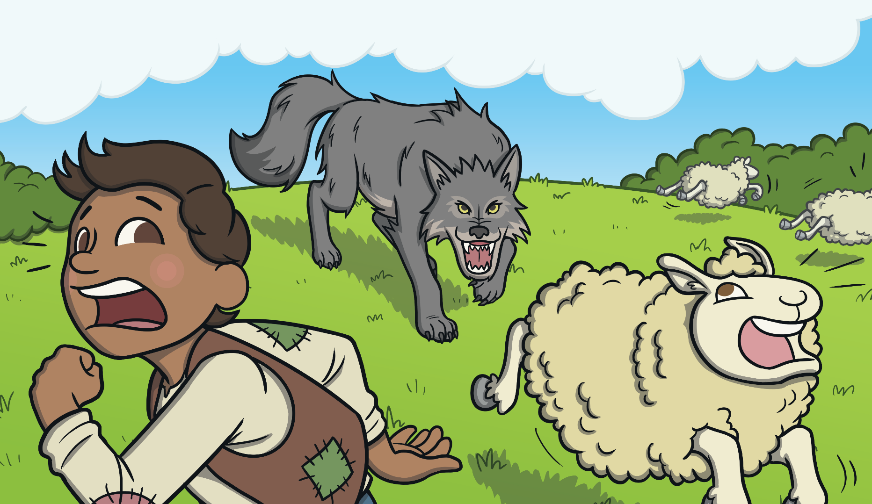
Later that day, a wolf did come into the field. The boy shouted and shouted, “Wolf! Wolf!” This time no one came to help, and the wolf ate
all of the sheep.

Slide 7


The moral of the story is, “If you tell lies, people won’t believe you when you do tell the truth.”

