Slide 1


Slide 3


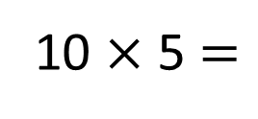
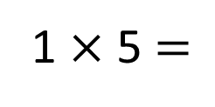
1) What number is shown?
2) What number is shown?
3)
4)
1 $×$ 5 $=$
10 $×$ 5 $=$

Slide 4
1) What number is shown?
2) What number is shown?
3)
4)
8
80
1 $×$ 5 $=$
5
10 $×$ 5 $=$
50

Slide 6

10
There are _____ eggs in one box.
There are _____ eggs in two boxes.
There are _____ eggs in three boxes.
20
30

Slide 7
10
10, 20 and 30 are all multiples of _____ .

Slide 8

Have a think
What are the missing numbers?
50
60
70
80
90
100
110
210
220
230
240
250
260
270

Slide 9
Have a think
What are the missing numbers?
0
10
20
30
40
50
60
90
100
110
120
130
140
150

Slide 10
Have a go at questions 1-2 on the worksheet.

Slide 11



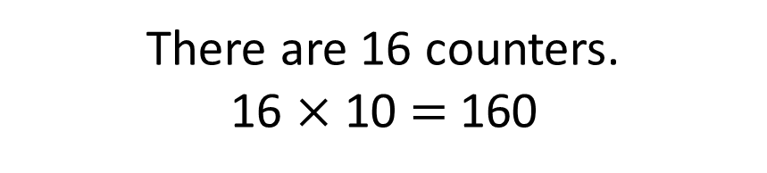
What number is this?
So 160 is a multiple of 10
If I make a number only using 10-counters, the number will be a multiple of 10
There are 16 counters.
16 $×$ 10 $=$ 160
That’s right! Well done Tiny!
Have a think

Slide 12
Have a go at questions 3-5 on the worksheet.

Slide 13

Multiples of 10 | Not multiples of 10
1
30
501
200
89
90
What do you notice?
I know ___ is a multiple of 10 because ___
I will sort these numbers!

Slide 14
Multiples of 10 | Not multiples of 10
7
19
50
300
101
20
Sort these numbers.
Have a think

Slide 15






Pencils come in packs of 10
Class 3 have 310 pencils.
How many packs of pencils do they have?
31
10 $×$ ___ $=$ 310
10 $×$ 10
10 $×$ 10
10 $×$ 10
1 $×$ 10
Have a think
0
100
200
300
310

Slide 16
Have a go at the rest of the worksheet.

Slide 17



Slide 18
I do
You do

Slide 19
















Rosie
Alex
Amir
Whitney
Ron
Dexter
Annie
Tommy
Mo
Jack
Eva
Teddy
Max
Kim
Jo
Sam

Slide 20



Speech bubble text – replace with any character head.
Speech bubble text – replace with any character head.
Bee
Diddy
Tiny

Slide 21
27
342
300
2
20
7
40
M | HTh | Tth | Th | H | T | O

Slide 22
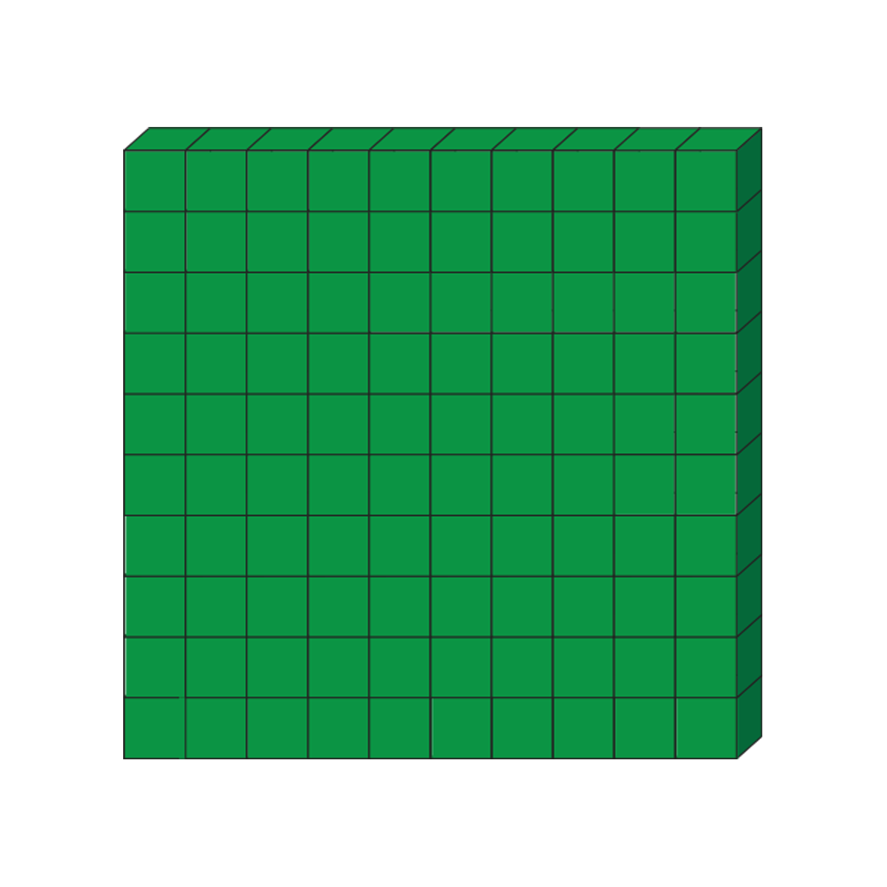

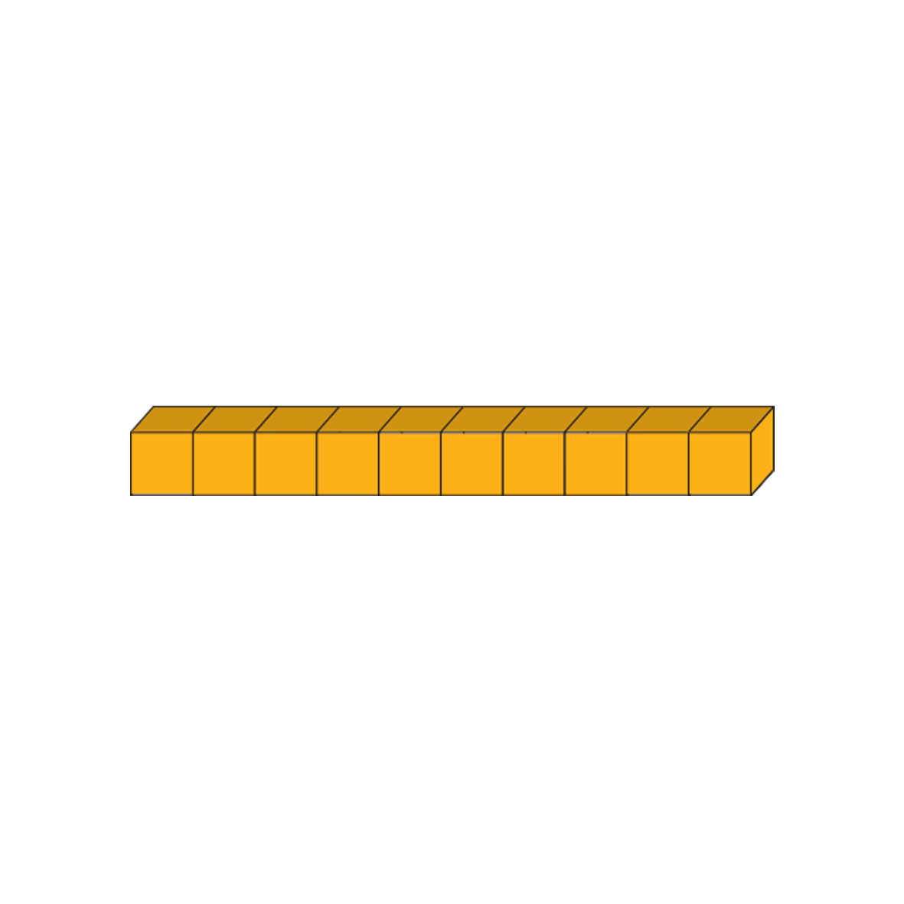







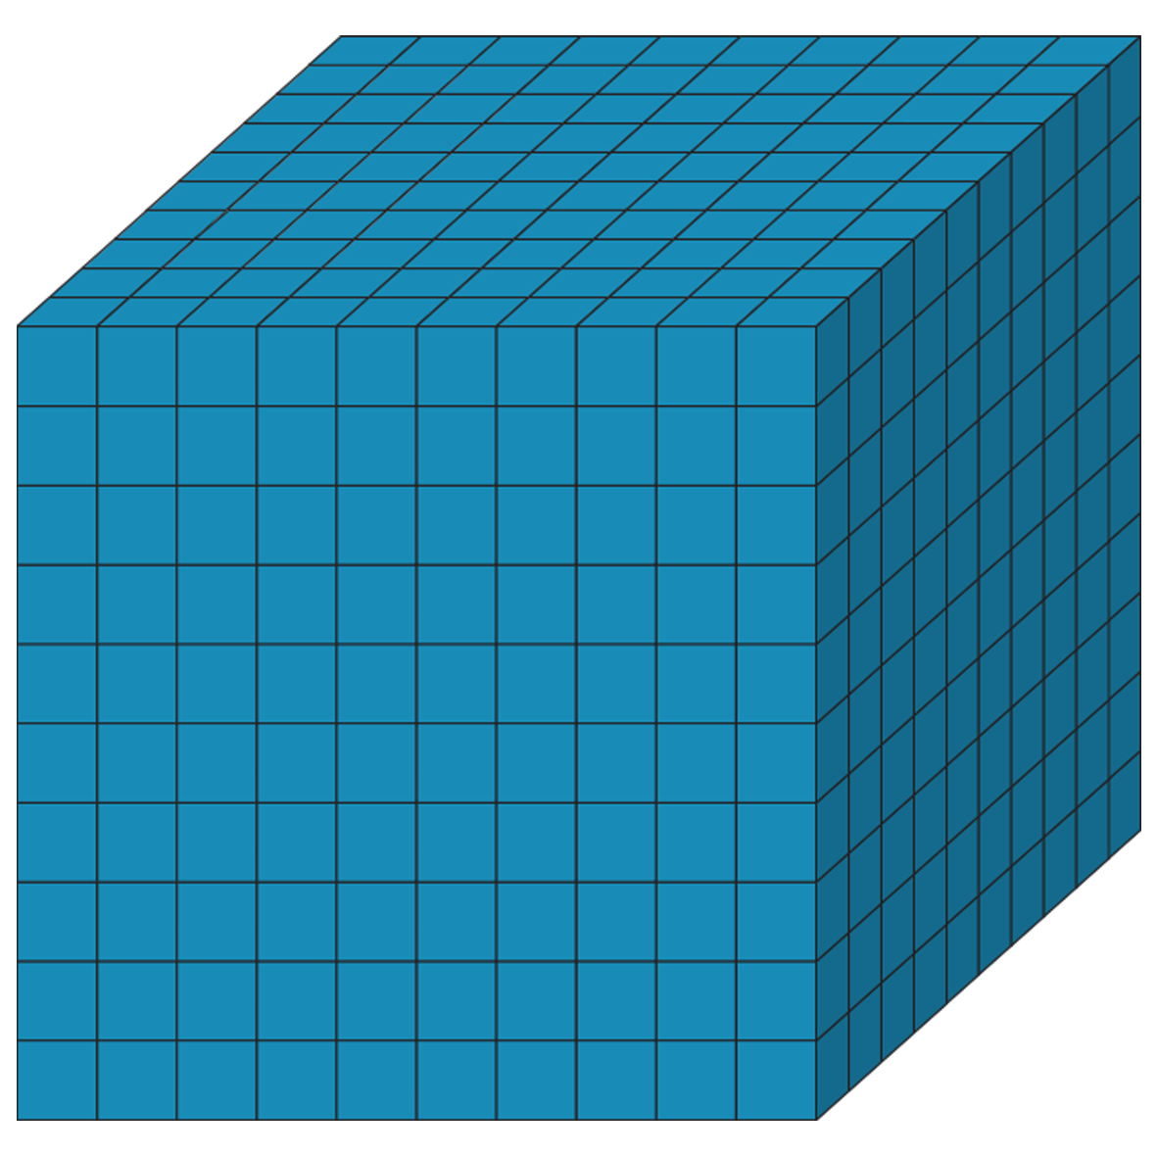
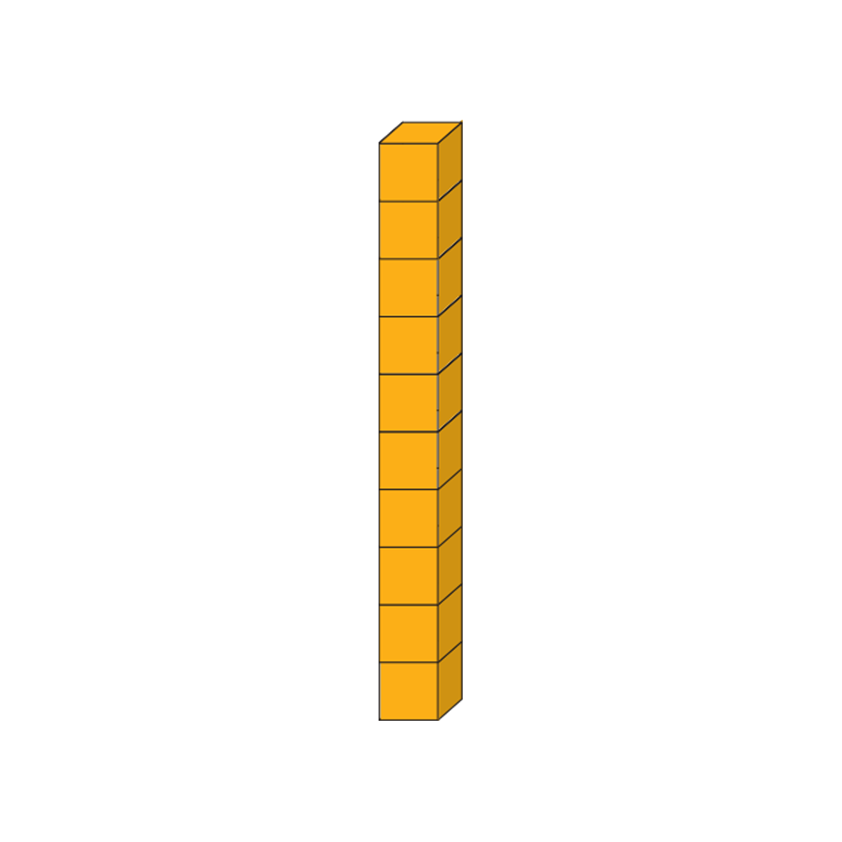





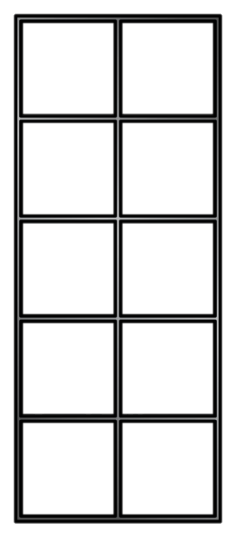
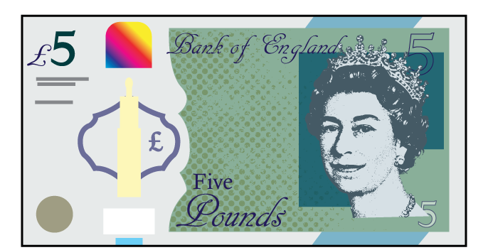

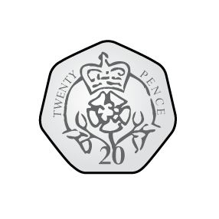
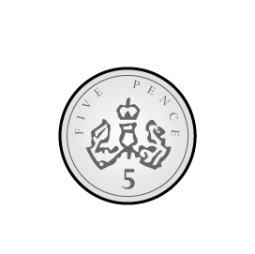
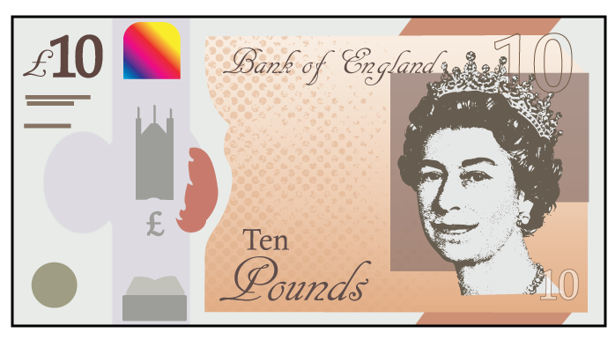


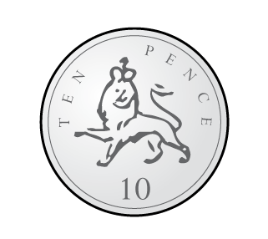
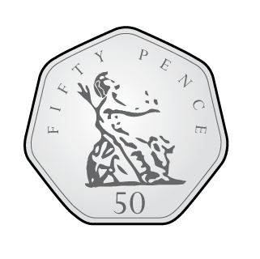

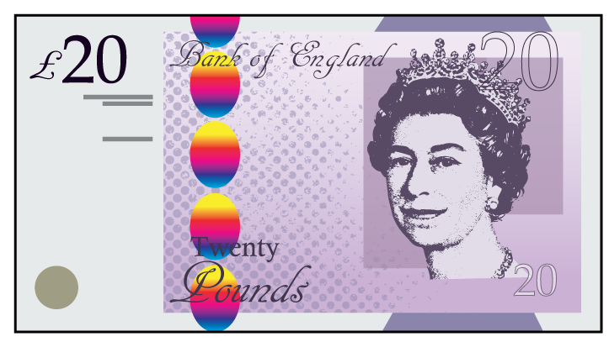
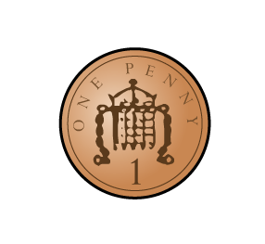

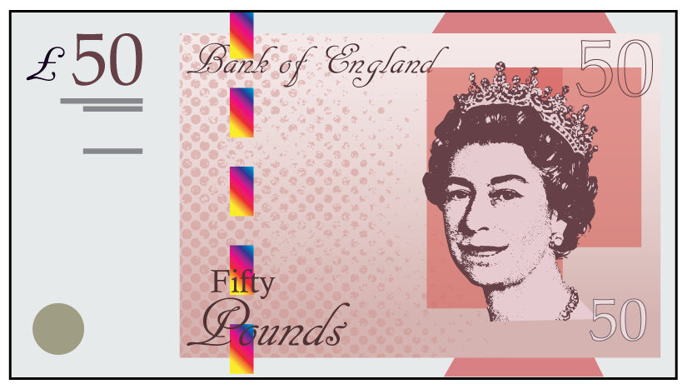

Slide 23
