Slide 1
Spring Week 3 - Science
The Lungs

Slide 2
Today we are learning about the lungs. Watch this video to find out about the structure of the lungs and how they work.
https://www.youtube.com/watch?v=hc1YtXc_84A&embeds_referring_euri=http%3A%2F%2Fhandyhomeschool.blogspot.com%2F&source_ve_path=Mjg2NjY&feature=emb_logo

Slide 3
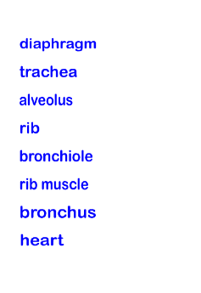
Using what you have learnt from the video and the words to the left, can you label the lungs on the next slide?

Slide 4
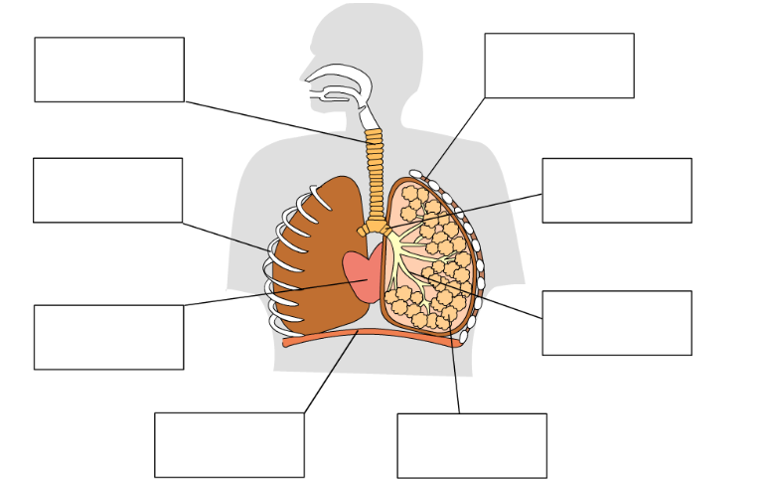

Slide 5
Task 2
Using your own knowledge, or do some further research, can you answer the following questions true or false?

Slide 6
