Slide 1
Spring Week 3 Spellings
Il and ir

Slide 2
Task 1
Can you find the 12 words for this week in the wordsearch at: https://wordwall.net/resource/10664542
Who can find them in the quickest time?

Slide 3
Task 2
Your words this week are:
Irresponsible Irresistible Irreplaceable
Irreparable Irremovable Irregular Illegal
Illegible Illiterate Illuminate Illustrations illness

Slide 4
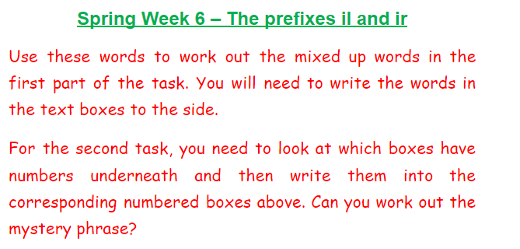

Slide 5
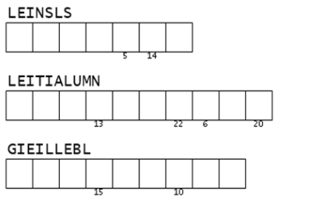

Slide 6
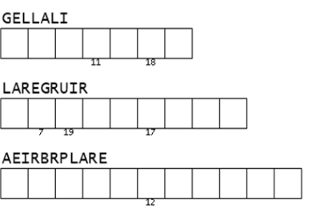

Slide 7
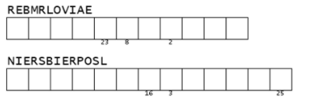

Slide 8
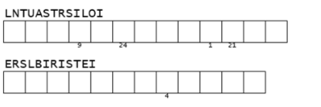

Slide 9
