Slide 1
Reading/Geography
Wednesday

Slide 2
Read the text then answer the questions in the boxes provided.

Slide 3
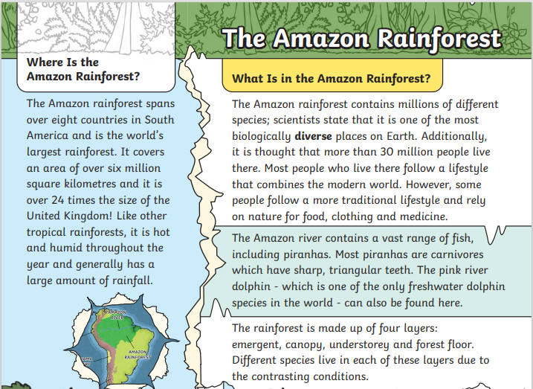

Slide 4
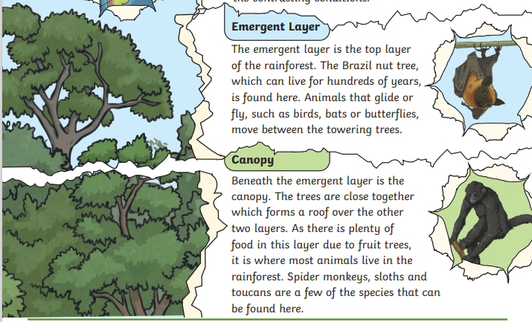

Slide 5
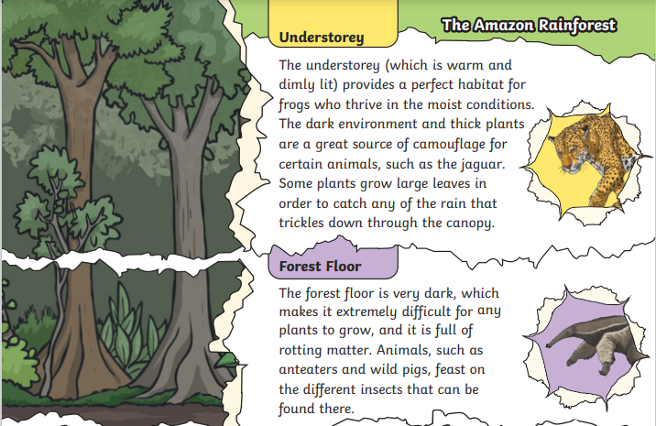

Slide 6
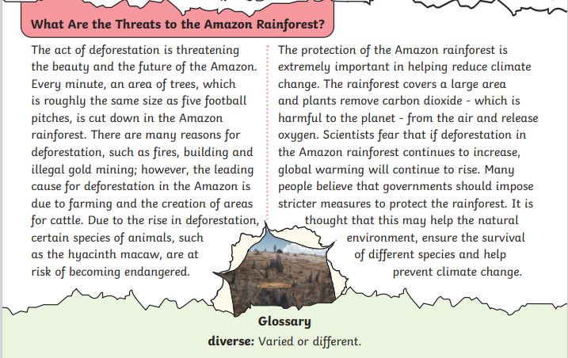

Slide 7
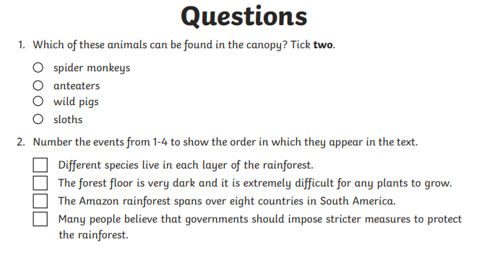
Write which 2 in this box

Slide 8


Slide 9
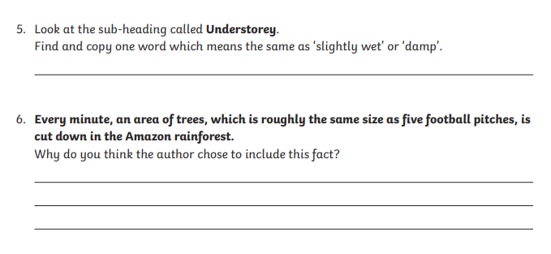

Slide 10
