Slide 1
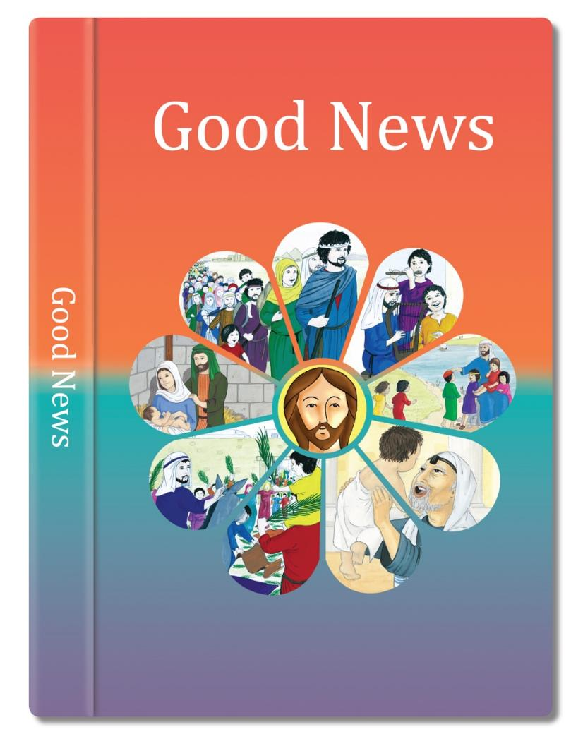
Watch the video link of the Gospel Story
https://www.youtube.com/watch?v=MpUaSilelzc
Try and write a diary entry as if you were one of the apostles.
How would you think and feel?

Slide 2
LEARNING FOCUS 1: Jesus chooses people to work with him.
CONTENT
Jesus proclaimed God the Father’s love by what he said and did. People who followed Jesus Christ in the early Church began to be called Christians. They formed a Christian community called the Church. At the beginning of his ministry on earth, Jesus chose certain people to follow him and share in his work. They were to be apostles and would be sent out to spread the Good News.
Read the story from God’s Story 3 page 90 I Have Chosen You, Mark 3: 13-19 – God chooses people to serve him today through their parish communities.
ANSWER THE KEY QUESTIONS
How do you think the apostles felt when Jesus chose them to help him in his work?
Why do you think he chose people to help him?
What do you think the Good News is?

Slide 3

I Have Chosen You
1) Simon (whom Jesus called Peter – the rock)
2) James and
3) John, the sons of Zebedee (whom Jesus called sons of thunder)
4) Andrew
5) Philip
6) Bartholomew
7) Matthew
8) Thomas
9) James the son of Alphaeus
10) Thaddaeus
11) Simon the Zealot
Judas Iscariot
(he would, one day,
betray Jesus)
Jesus left the crowds behind and went up onto the mountain. He sent for some of his friends.
When they came he chose twelve of them to be his special friends and to help him in his work.
“I have chosen you to be my apostles,” he said, “I want to send you out to tell everyone the Good News of God’s love.”
These are the names of the twelve:
(Based on Mark 3:13-19)
God’s Story 3

