Slide 1
Alliteration Poems

Slide 2
Can you read through each alliteration poem and highlight the alliteration used.
Things to think about:
What is the theme of each poem?
How has the writer used the alliteration? For example, is it used in every line or within each verse?
Have they included adjectives, verbs or nouns?
Can you spot any other patterns used in the poems? For example, repetition or rhyming?

Slide 3
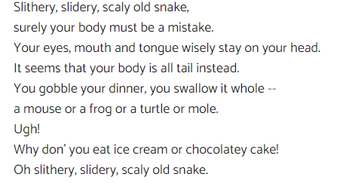

Slide 4
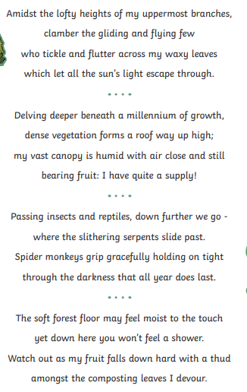

Slide 5
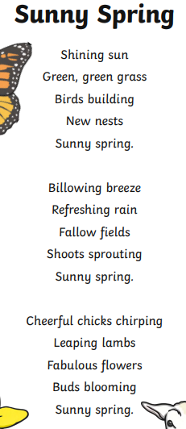

Slide 6
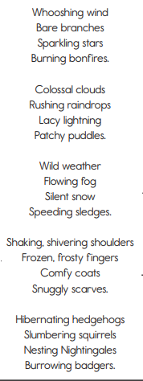

Slide 7
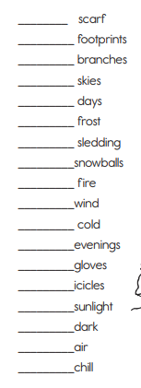
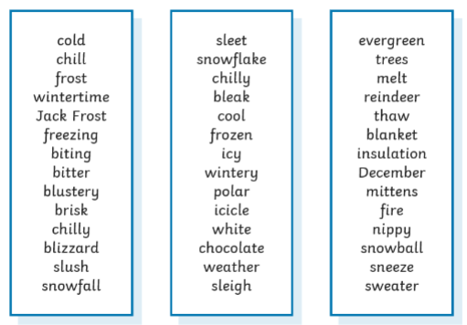
Can you come up with Adjectives, Nouns or Verbs to create alliteration with the words giving.
You can use the word bank below to help or come up with your own ideas.

