Slide 1
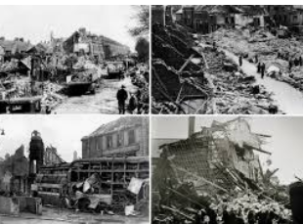
The Effects Of WWII On Jarrow
By Maeve T

Slide 2
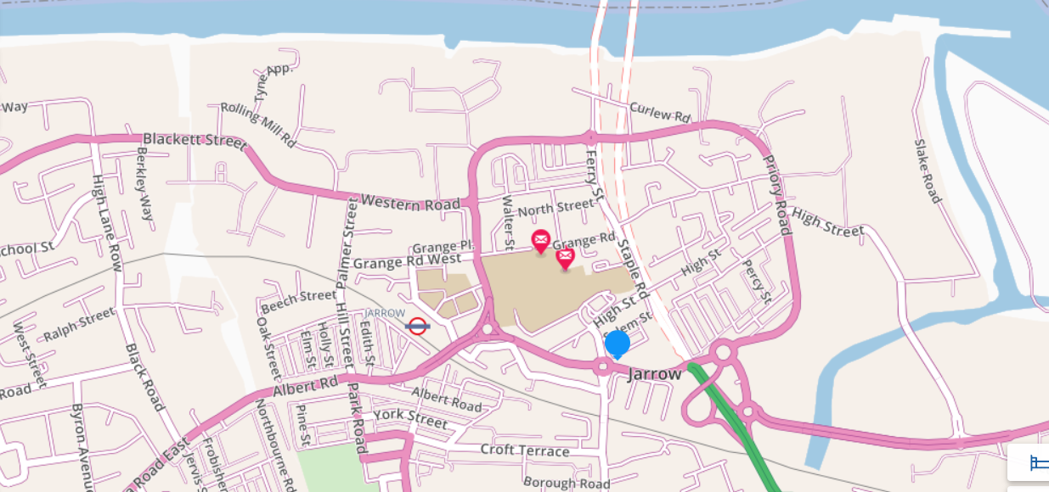
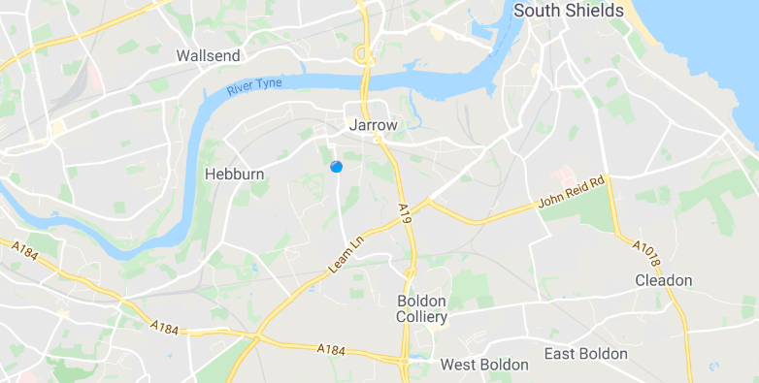
Where is Jarrow?
Jarrow is in the North East of England. It is between Newcastle and South Shields and bound to the north by The River Tyne. Hebburn is to the west, South Shields to the east and Sunderland to the South.
Jarrow in its local context
Jarrow in its wider context

Slide 3
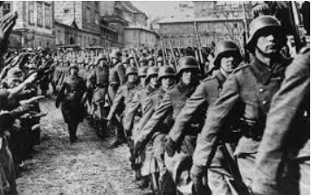
What caused WWII?
At the end of WWI, Germany was forced to sign the Treaty of Versaille, which forced Germany to lose it’s army, give up land and pay billions to make up for the damage caused during the war. Germany was very unhappy about this – they were left poor, hungry and humiliated. During this time, Adolf Hitler became leader of the Nazi party. He was a powerful dictator and became leader of Germany in 1933. Hitler promised to make Germany great again and quickly began to arm his country and invade others in order to gain more land for Germany to grow.
Shortly before 5am on Friday 1st September, 1939, German forces stormed the Polish frontier. Tanks and motorised troops raced into the country over ground, supported by Stuka dive bombers overhead. A total of 1.25 million Germans soldiers swept into Poland. Then Britain and France declared war on Germany after Hitler refused to abort his invasion of Poland.

Slide 4
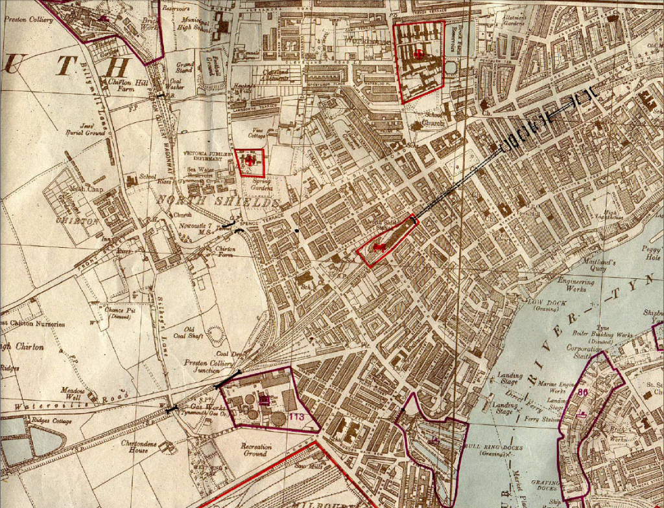
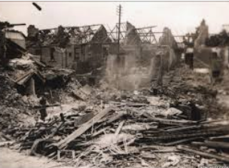
Why Was Jarrow Targeted?
Jarrow was one of the main targets of the Germans mainly because of the vast industry on the banks of the River Tyne, which included steel works and ship building. Jarrow was also hit when German bombers were also trying to target gas works on the north of the Tyne. Sadly, Jarrow was a victim of random attacks by German bombers as they attempted to get rid of their bombs before returning to Germany.
This is a German bombing plan for North Tyneside

Slide 5
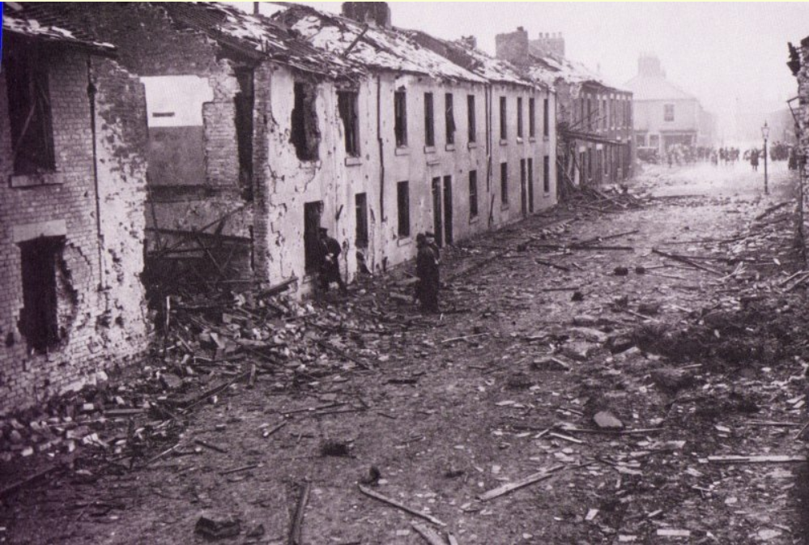
The Attack On Princess Street
One of the most devastating bomb attacks in Jarrow was on Princess Street on Wednesday 3rd of July 1940 at 6.10pm. This was started by a bomb being dropped on Newcastle Quayside, which started a huge fire and the air raid siren was sounded. Shortly afterwards the all clear signal was given, however a lone German bomber was hiding behind in the clouds. The bomber glided down and released a whole salvo of bombs (about 4 to 6) over Princess Street, Dunn Street school and Stanley Street. The bombing target would have been aiming for the petrol tanks at the end of High Street but luckily the fire men reached the area in time and got rid of all petrol.
Four or five streets were affected but most casualties occurred in Princess Street. A search of the debris went on throughout the night for trapped victims. Sadly, thirteen people lost their lives and over a hundred were injured.

Slide 6
Wartime Letters from 84 Bede Burn Road
From my research I’ve come across some wartime letters from Jarrow written by a lady called Cecilia Brennan on a website called donmouth.co.uk. She was a teacher at St Bede’s School and lived with her parents on Bede Burn Road. In one of her letters she has written about the attack on Princess Street. Here are some extracts:
“Then the air raid syren went and we hid under the stairs hearing occasional crashes. After an interval the all-clear signal went and we emerged from a cupboard. About ten minutes later there was a terrific crash and the whole house shook. I felt as if the place was descending on top of me”.
“The dreadful thing was that the people were all out in the street (seeing that the all-clear had sounded) and that accounts for the appalling number of casualties. Up to now there are 11 dead and over a hundred wounded. All the dead are Catholics. One family has father, mother and three children dead”.
“We went into school this morning at 9 am and some of the poor little souls, white-faced and tired-looking, were there, but we sent them home. Our school in Harold Street is a hospital and it was full of patients and nurses..... A boy died in the hospital in our school this morning”.
“It is pitiful that it is the poorest section of the people that have lost everything, their homes and their bits of furniture”.

Slide 7
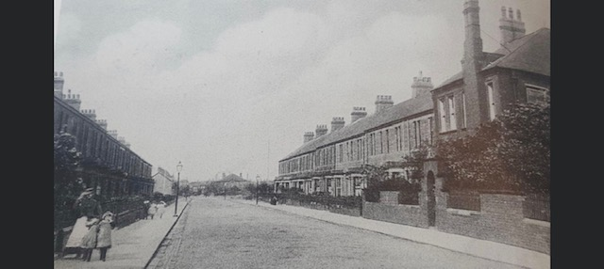
My Thoughts
I live on Bede Burn Road a few doors away from Cecilia’s house and I couldn’t imagine living in Jarrow during the war and experiencing the fear that locals must have felt when the air raid sirens went off. In our house now it is quite quiet but during the war, it must have been terrifying to suddenly have the peacefulness disturbed by the sound of bomber planes overhead and bombs being dropped. I can’t imagine having to hide under the stairs in fear, as the people who lived in our house in the past would have had to do. It’s amazing to think of what our house, street and the town of Jarrow has withstood.
Bede Burn Road in the early 20th century

