Slide 1
Some facts
Jarrow is a town in north-east England, located on the River tyne. Historically part of County Durham, in 1974 it became part of the metropolitan county of Tyne and Wear. In the eighth century, the monastery of Saint Paul in Jarrow (now Monkwearmouth-Jarrow Abbey) was the home of Bede, who is regarded as the greatest Anglo-Saxon scholar and the father of English history. From the middle of the 19th century until 1935, Jarrow was a centre for shipbuilding, and was the starting point of the Jarrow March against unemployment in 1936. Jarrow had a population of 43,431 in 2011.

Slide 2
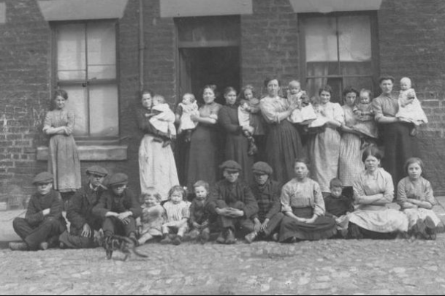
The people
It must have been hard for the people in them days with trade and rulers. But Jarrow has really interesting past and they had different money to us now. A Lot has changed, but we still have similar things and that's where we get stuff from. Like when the Romans came to England we got a lot of them like central heating, burgers and baths.A lot more.

