Slide 1
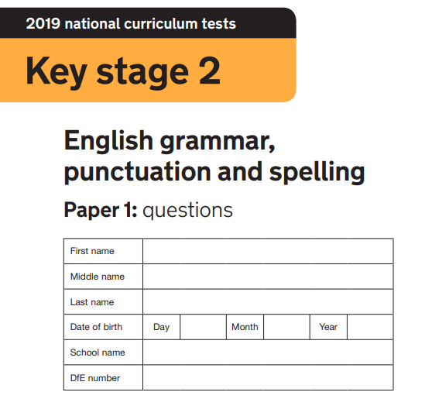
2020
Mark my grammar test for me, please… how did I do?!
Miss Wib’s
393/3311

Slide 2
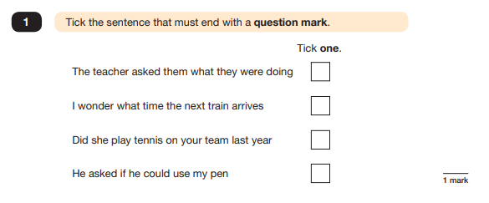
Write here:

Slide 3
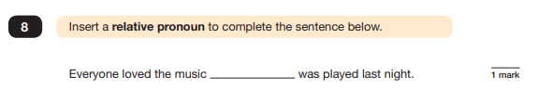
2
what
Write here:

Slide 4
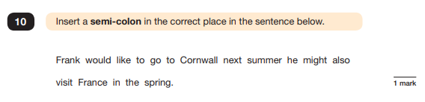
3
:
Write here:

Slide 5
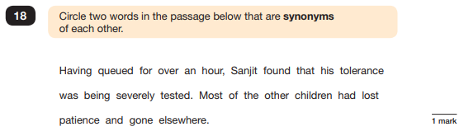
4
Write here:

Slide 6
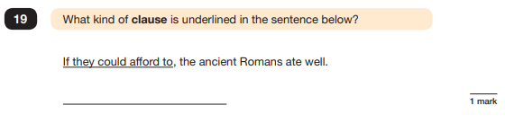
5
Santa Clause
Write here:

Slide 7
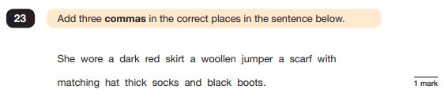
6
,
,
,
,
Write here:

Slide 8
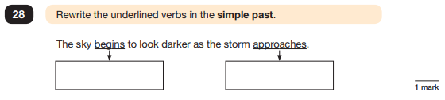
7
Began
aproached
Write here:

Slide 9
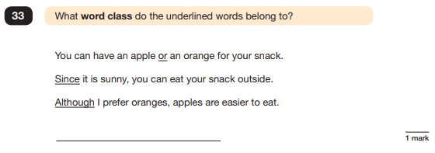
8
Mountains class
Write here:

Slide 10
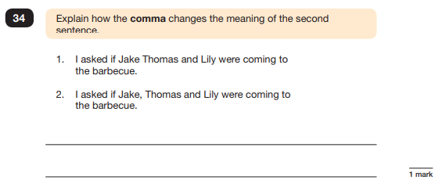
9
You breathe where the comma is so in the second one the speaker is obviously out of breath
Write here:

Slide 11
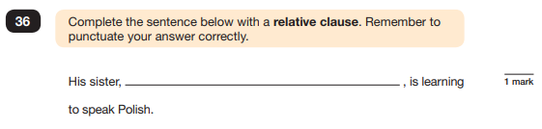
10
a relative clause
Write here:

Slide 12
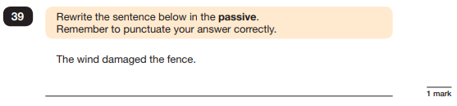
11
the fence was damaged by the wind.
Write here:

Slide 13
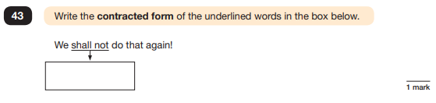
12
shall’ot
Write here:

Slide 14
How did I do? ☺

