Slide 1
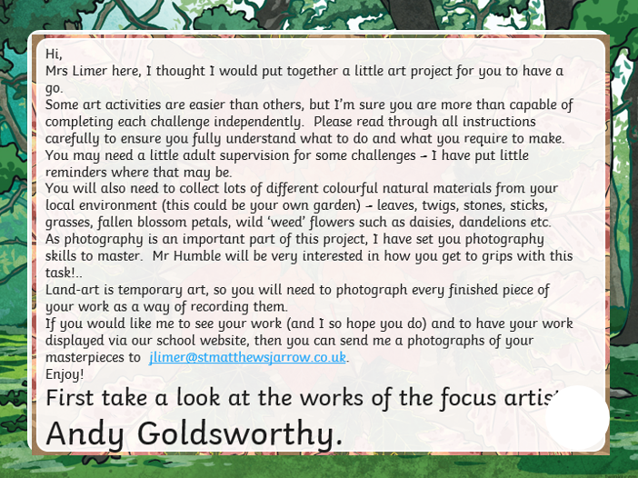

Slide 2
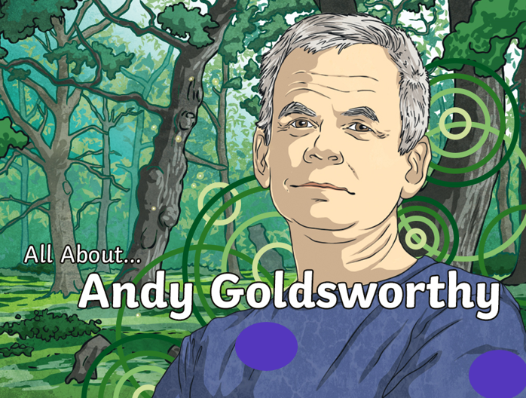

Slide 3
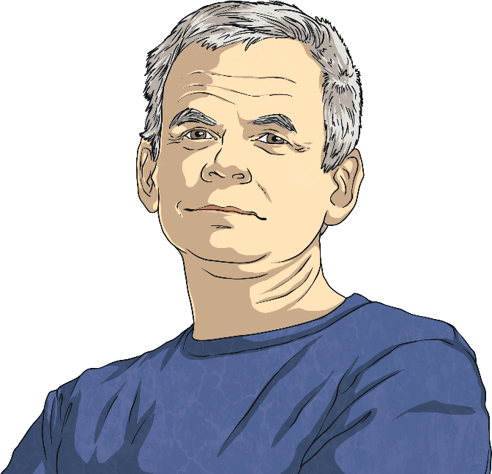
Andy Goldsworthy
Andy Goldsworthy is a British artist. He is known for his work in sculpture and photography. Andy is an environmentalist and this is reflected in the nature-based aspect of much of his work.
Andy was born on 25th July 1956 in Cheshire. When Andy was 13, he got a job as a labourer on a farm.
He studied fine art at Bradford College of Art. Fine art is often described as ‘art for art’s sake’; drawings, sculptures and paintings that have no use other than being beautiful.

Slide 4
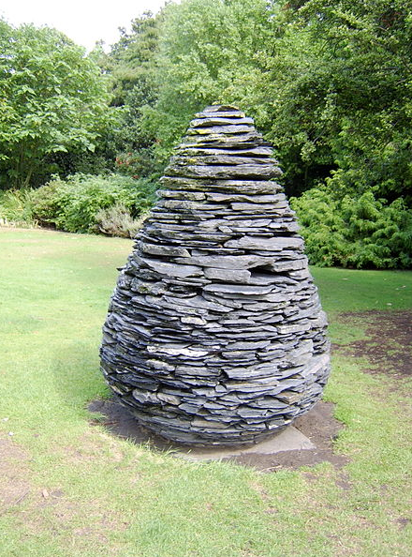
Nature
Andy describes his art as working “with nature as a whole”. His sculptures are often made up of stones, twigs, flowers, mud, snow and icicles. Many of Andy’s sculptures are created on the site where the objects are found. This is called land art or environmental art.
This is one of Andy’s slate cone sculptures. Andy cut different shapes of slate and put them together in the shape of a pine cone. There are several versions of this sculpture across the world. This one is in the Botanical Gardens in Edinburgh.
“Slate Cone” by Wolfgobbler is licensed under FAL

Slide 5



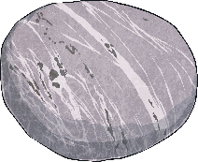
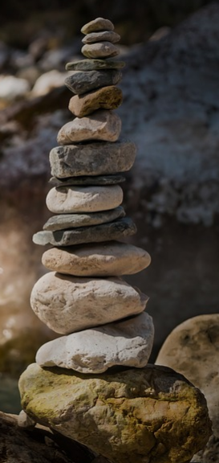
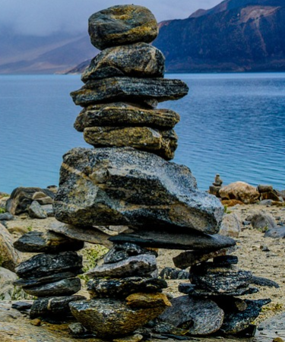
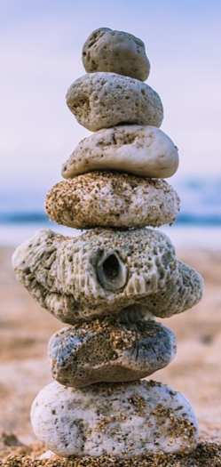
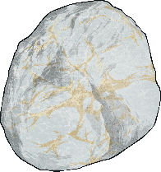
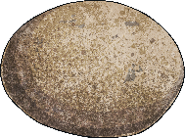

Rock Balancing
Andy has made rock balancing popular. Rock balancing is a form of art where rocks and pebbles are balanced on each other without using glue, wires or anything else to keep them together (you can find lots of these on the shore line at Holy Island). It can be done on a small or large scale. Here are some examples of rock-balancing sculptures that people have made.

Slide 6
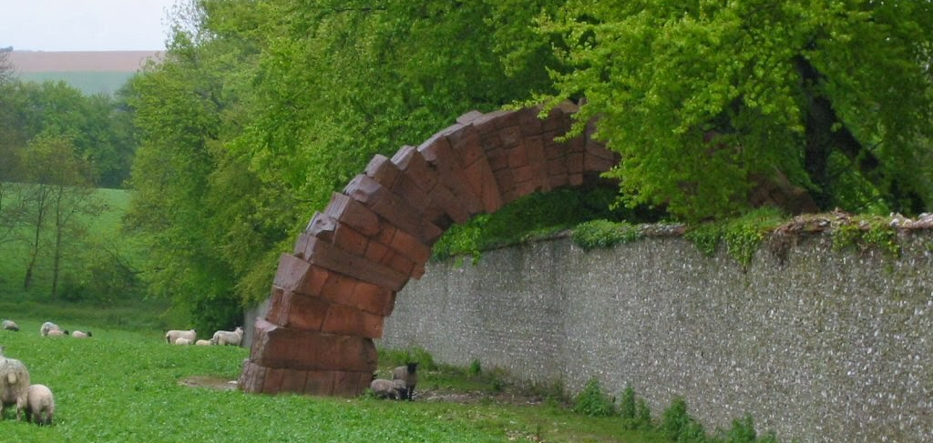
Striding Arches
This is part of a project called Striding Arches in Cairnhead, Scotland. It is made of red sandstone and goes across a large, circular wall. Andy has also made arch sculptures in other parts of the world.

Slide 7
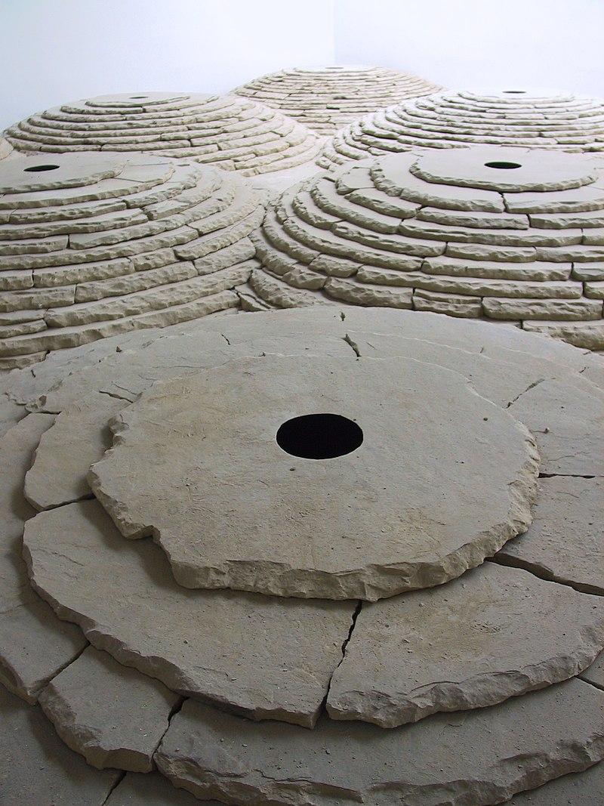
Life As An Artist
Andy now lives in Dumfries and Galloway, Scotland. In 2000, he was given a special award called the OBE (Order of the British Empire) by The Queen. This means his full title is Andy Goldsworthy, OBE.
A director named Thomas Riedelsheimer has made two films about Andy’s life, called ‘Rivers and Tides’ and ‘Leaning into the Wind’.
Andy continues to travel the world building on-site sculptures.

Slide 8
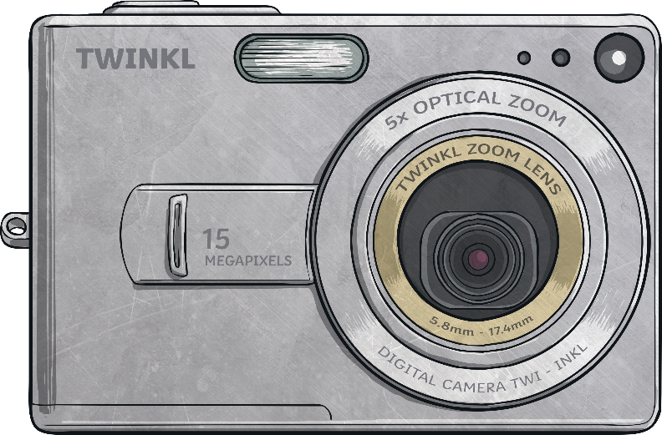
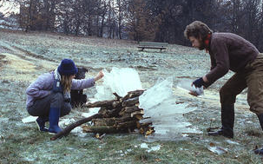
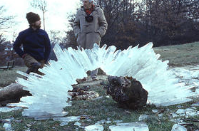
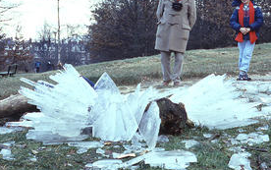
Photography
Andy also works with photography. He often takes photos of his sculptures over time to show how nature changes them.
Explaining why he takes photos, Andy said, “Each work grows, stays, decays… parts of a cycle which the photograph shows at its heights, marking the moment when the work is most alive.”
Shot 1 - Making
Shot 2 -Finished
Shot 3 -Collasped
You will see a really good example of time lapse photography taken by
Mr Humble in a later slide.

Slide 9
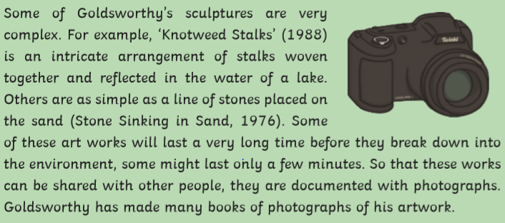
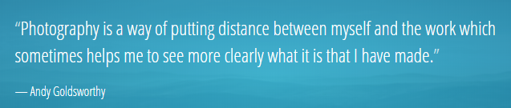

Slide 10
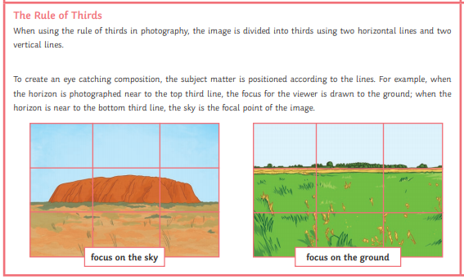
Mr Humbles Top-Tip -
How to take the ‘Perfect Picture’!

Slide 11
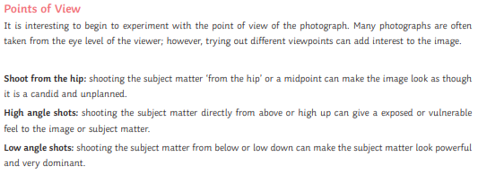
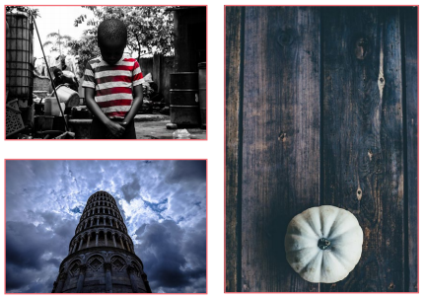
So remember these important points when taking photographs of your own
landart.

Slide 12
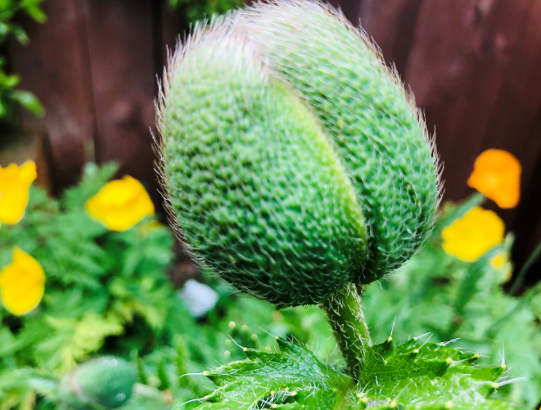
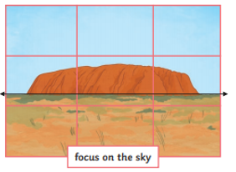
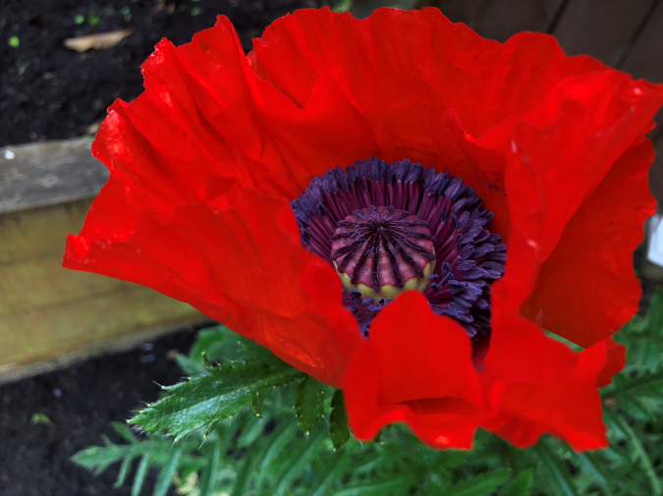
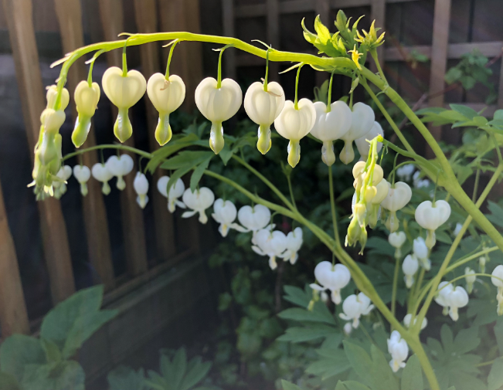
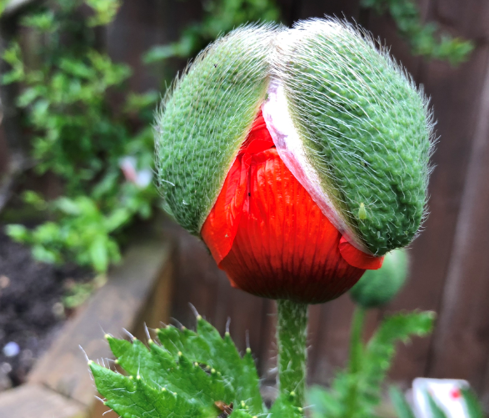
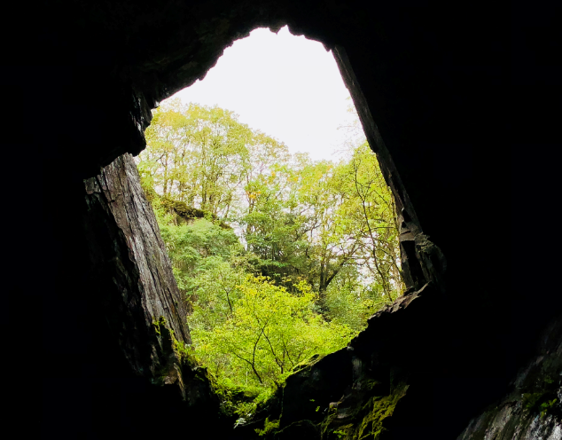
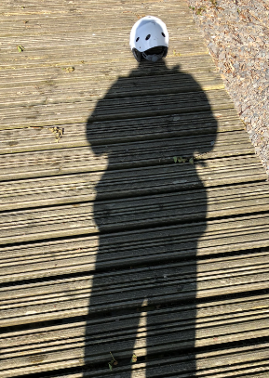
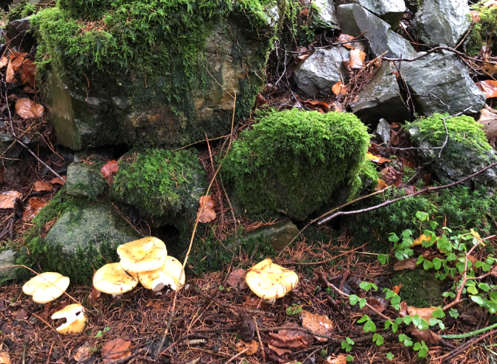
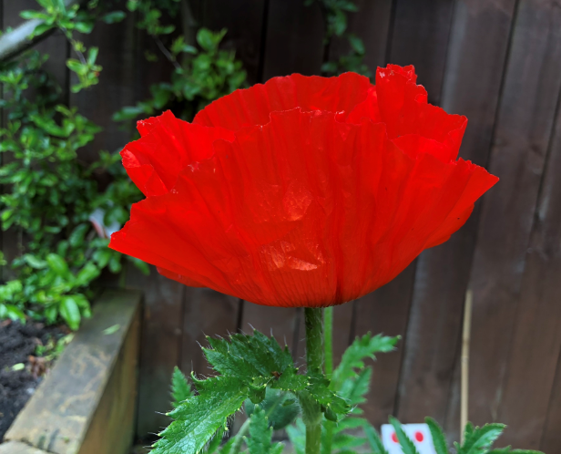
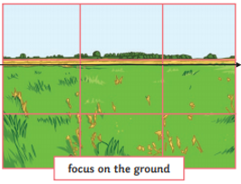
Time lapse photography
taken from different
viewpoints.
Framing the subject
Having a bit of fun with the camera. This shot captures Mr Humbles’ shadow perfectly placed over
a safety hat left lying on a jetty.

Slide 13
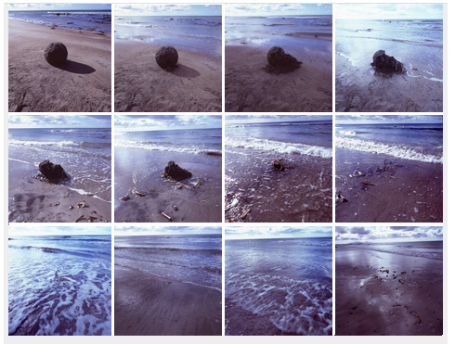
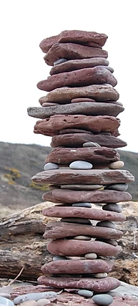
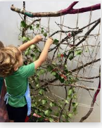
How to be a ‘Land Artist’
There are lots of ways you can create your own Andy Goldsworthy inspired art:
Rock balancing – get different-sized rocks and pebbles and experiment balancing them on top of each other to create your own rock-balancing sculpture.
Land art – go outside and find natural resources, such as rocks, sticks, twigs, leaves and mud and create an interesting arrangement or structure using these materials.
Photography – take photos of things outdoors at different times of the day. Look at how they change.

Slide 14
Challenge Land Art
Ok, lets get creative!
I have set you several challenges, which will enable you to explore, experiment and replicate some of the land art works of art by Andy Goldsworthy and create some ‘Masterpieces’ of your own.
With each challenge, take your time to think, plan, explore and experiment with the materials and techniques to arrange and join to create a finished piece of land art. As this is temporary artwork, make sure you photograph each piece to keep a record of your work.
Andy uses: Stone, wood, Ice, leaves, flowers and photography to create his works.
Let’s see if you can create your own land art using some of the same materials from nature!

Slide 15
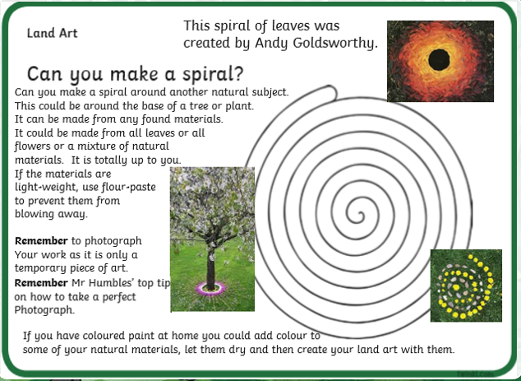

Slide 16
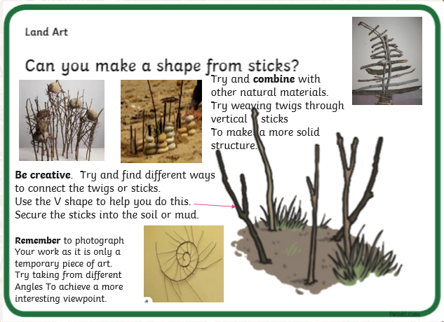

Slide 17
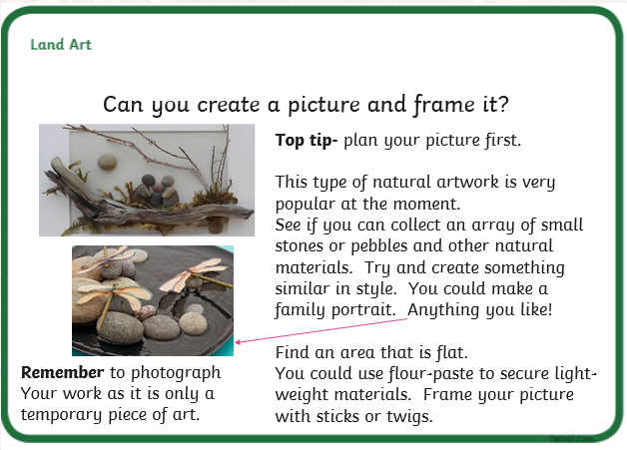

Slide 18
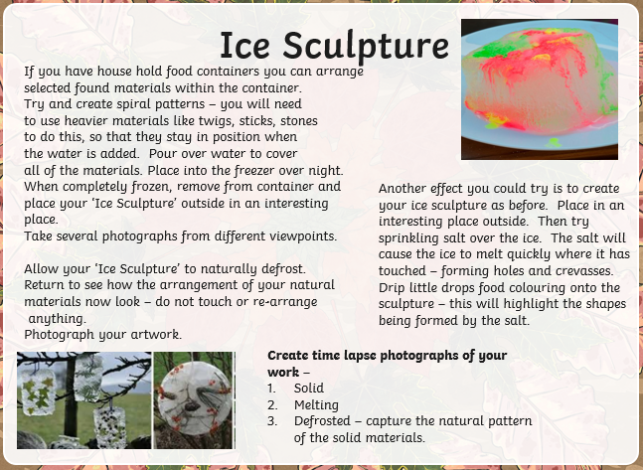

Slide 19

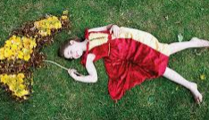
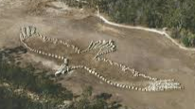
You could create a large piece of land art on the ground that could be seen from an upstairs window. Have a family member interact with your land-art. Capture the image using your photography skills.
Create an outline image of a bird, insect or flower.
Top-tip:
Plan your work first.
You could use flour or small grain pulses to layout a guideline of your desired shape and then place the natural materials over.

Slide 20
Let’s have a go at mastering your photography skills!
Your task is to use a camera to capture interesting images found in your own or local environment. This could be unusual patterns found in nature, such as tree bark or you may see human characteristics in the shape of a trees branches. You may simply discover something really beautiful and feel inspired to take a photograph of it.
Remember to use the rule of thirds and a variety of viewpoints:
shoot from the hip
high angled shots
low angle shots.
You could try capturing some time lapse shots. Maybe an opening flower, just like Mr Humble did with the beautiful Poppy.
It is up to you.
Take a look on the next slide of some of the interesting patterns and shapes I captured on camera during my daily exercise out and about. I tried my best to follow Mr Humbles advice.

Slide 21
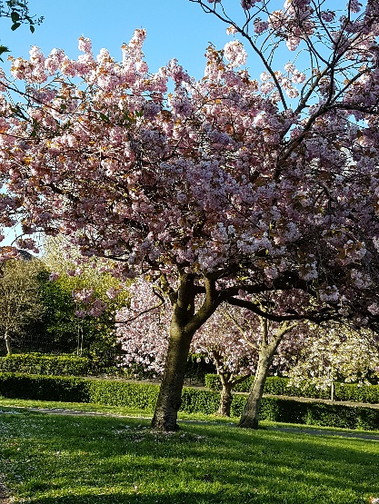
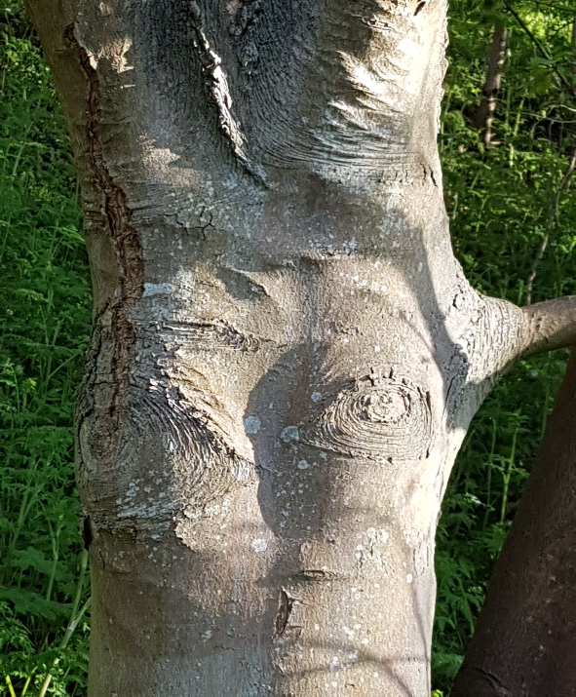
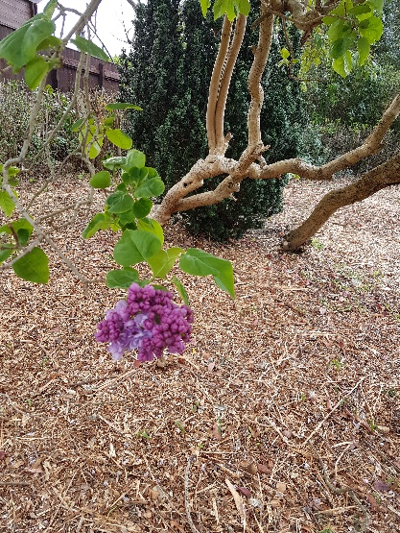
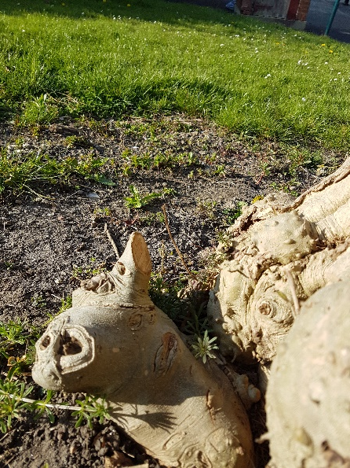
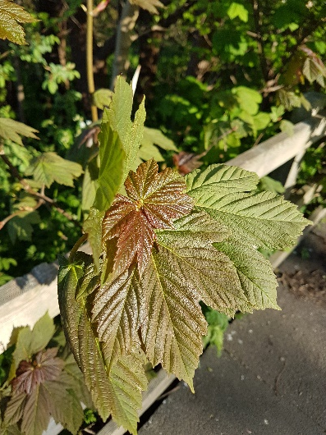
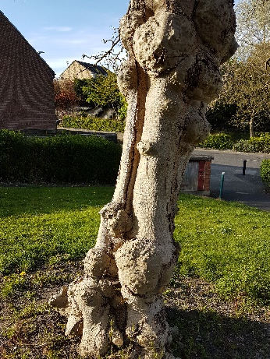
Taken with the main subject to the left
Taken from the hip.
Taken from a high angle
Taken from low angle

Slide 22
Good luck – have fun and be creative!
I can’t wait to see your work.

Slide 23
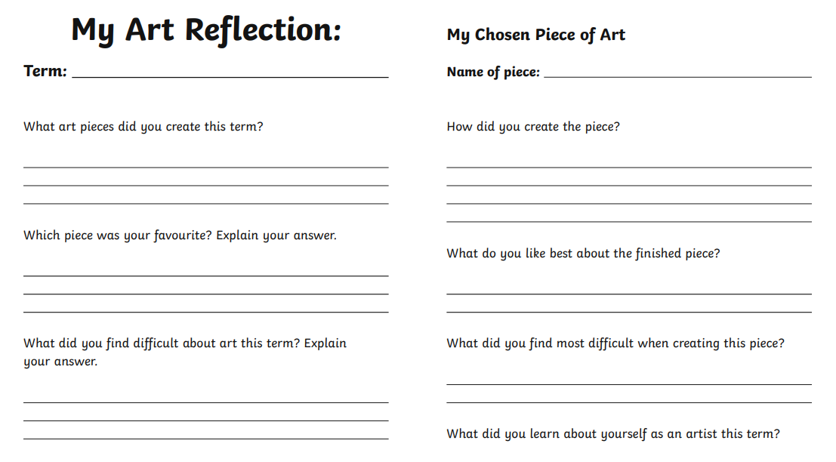
Now it is time to Reflect on the work you have completed during this project.
You can download a prepared worksheet and fill in the reflective questions or complete the worksheet online (word document).
I would love to read your thoughts about your artwork and the art challenges I set you. Also I’m so looking forward to seeing your fabulous photographs of your land-art creations.
I know Mr Humble will be very interested to see how well you mastered using his top tip – ‘The rule of thirds’.

