Slide 1
Hi,
Mrs Limer here, I thought I would put together a few Art challenges to support your child’s creative development and occupy their minds and hands for a few hours. You can support your child to enable them to create these activities independently or work together as a family to create collaborative pieces of artwork.
To complete the art challenges and main land art activity, you will need to collect a selection of found natural materials from your local environment – leaves, twigs, sticks, stones, grasses etc. This could be sourced from your own garden or collected during a nature walk out.
Once the different art challenges have been completed – drawing, printing, collage, painting, Kinetic (moving art work) your child can now use their knowledge of creating land art to create a main piece in the style of the focus artist. You could try and incorporate some of the challenge artwork completed within this piece too!
Your final piece of artwork can be created in your own garden. It can be laid out flat onto the ground or you can try and stack your found materials to make an upright sculpture.
As most of this artwork is only temporary, you will need to photograph your child’s finished land-art so that they can keep a record of it. If possible, encourage / support your child to do this for themselves. I would love to see pictures of their artwork too – you can send them back to me via Google Classroom.
First take a look at the works of the focus artist Andy Goldsworthy via my information slides, which you can show and read aloud to your child.

Slide 2
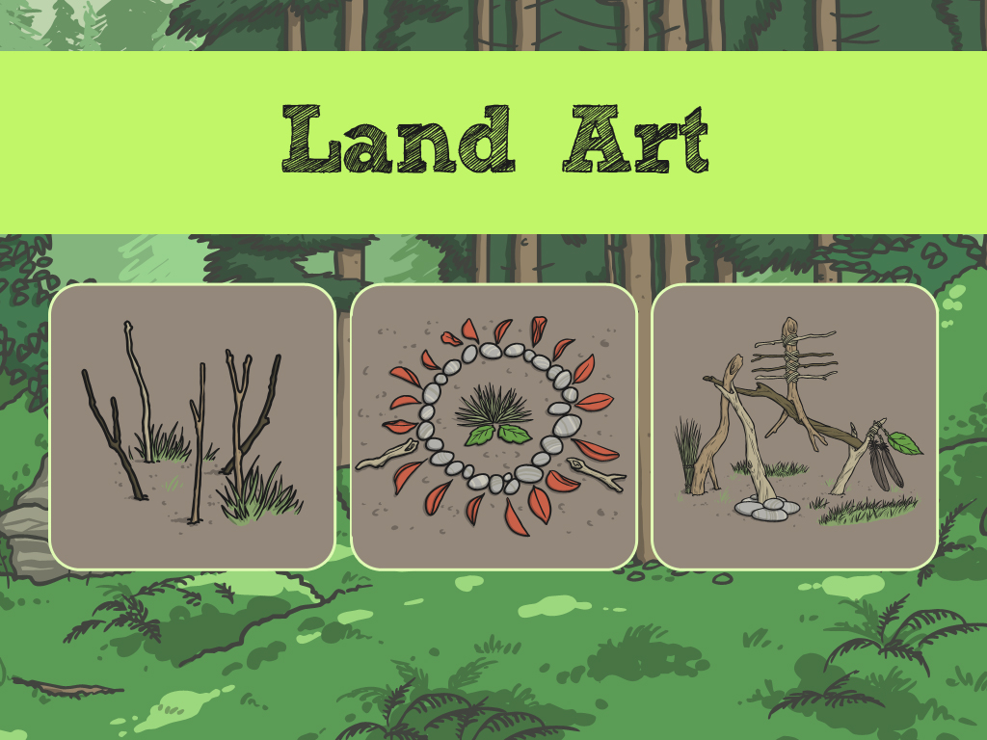

Slide 3
Aim – you can explain to your child that this is what they are going to learn.
I can make my own land art.
I can talk about the artist Andy Goldsworthy.

Slide 4
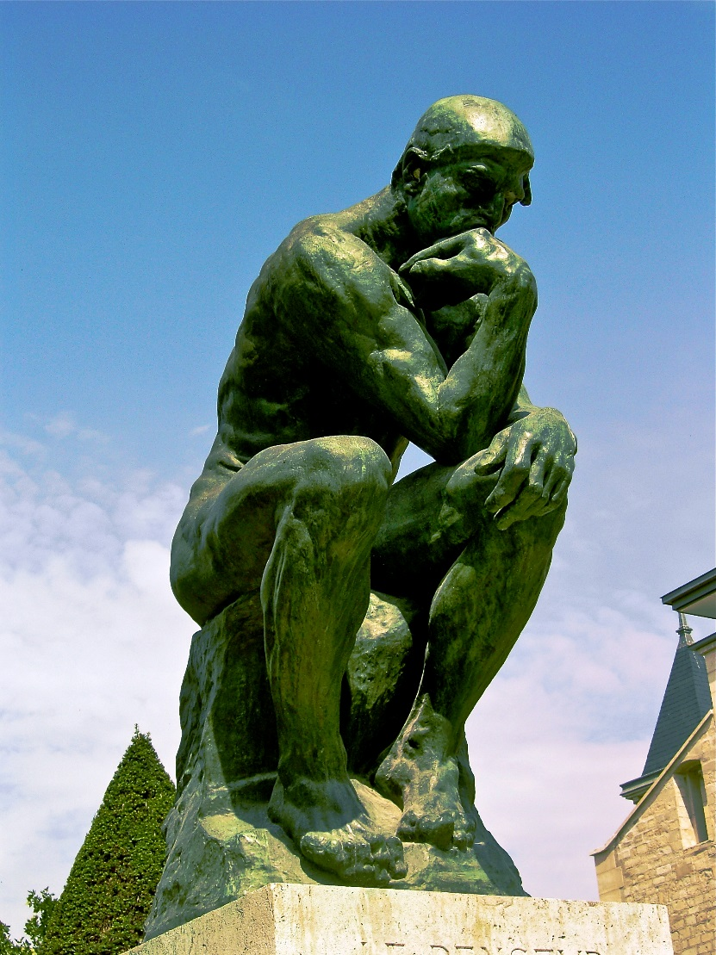
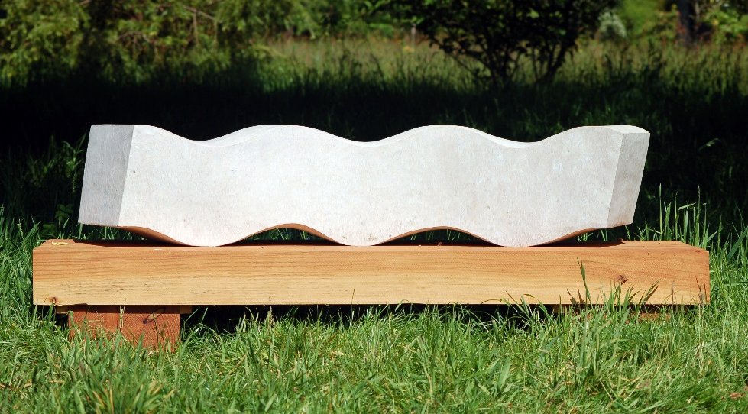
Sculpture
Sculptures are works of art.
Sculptures are 3-D models.
They are not flat like paintings and drawings.
Photo courtesy of archer10 (Dennis) (@flickr.com) - granted under creative commons licence - attribution

Slide 5
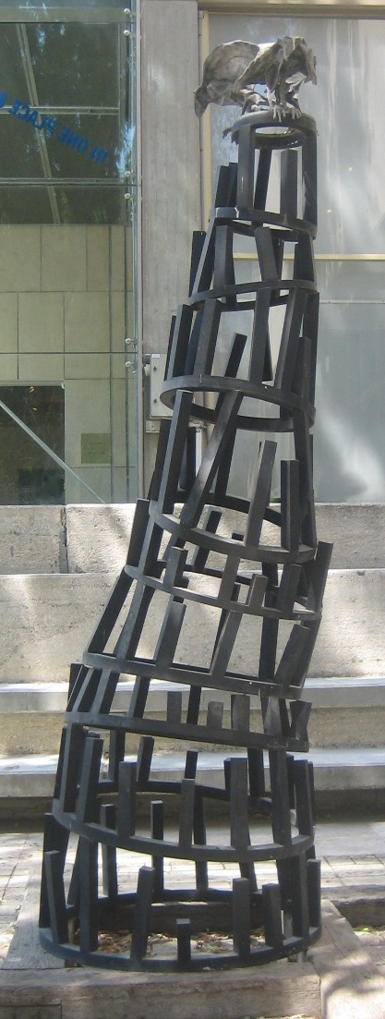
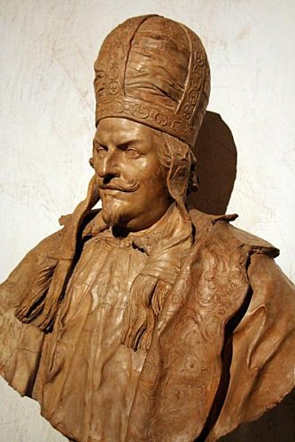
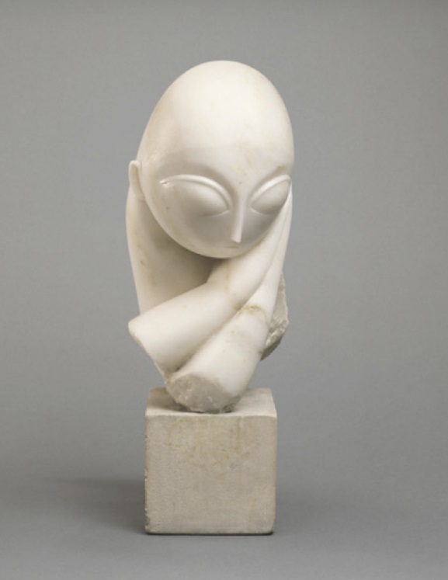
Materials
Most sculptures are made of metal, clay or stone.

Slide 6
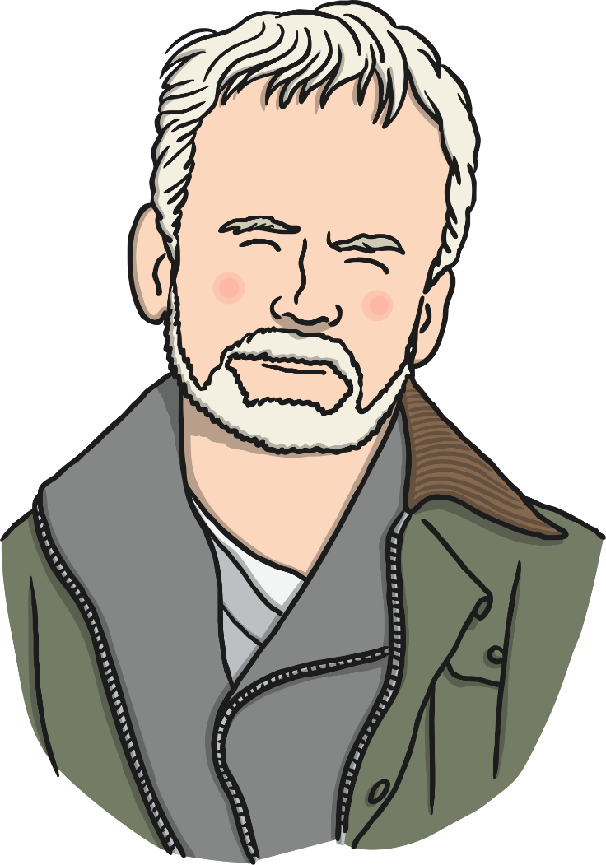
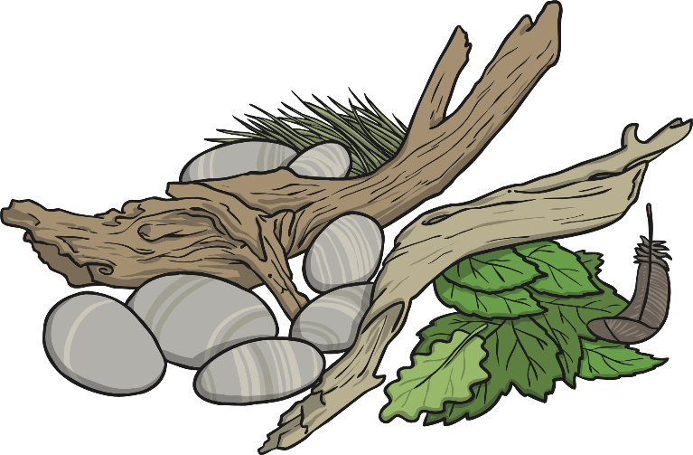
Andy Goldsworthy
Andy Goldsworthy is an artist who makes sculptures from natural materials like rock, sticks and leaves.

Slide 7
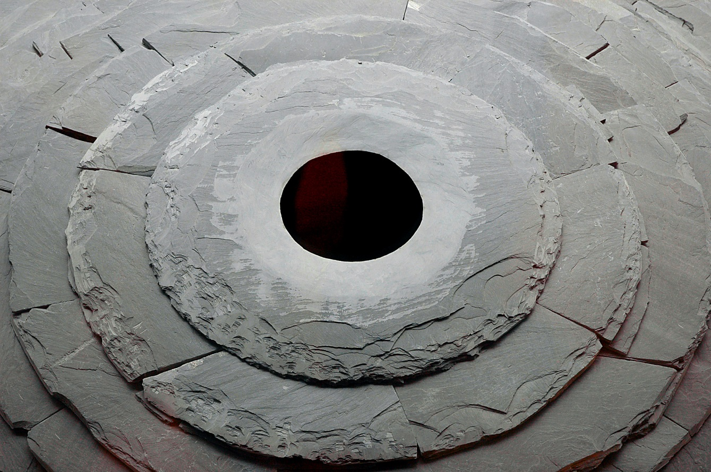
Andy Goldsworthy
This sculpture is made out of a rock called slate.
Roof,
2004 - 2005
Photo courtesy of Thom Watson (@flickr.com)-granted under creative commons licence- attribution

Slide 8
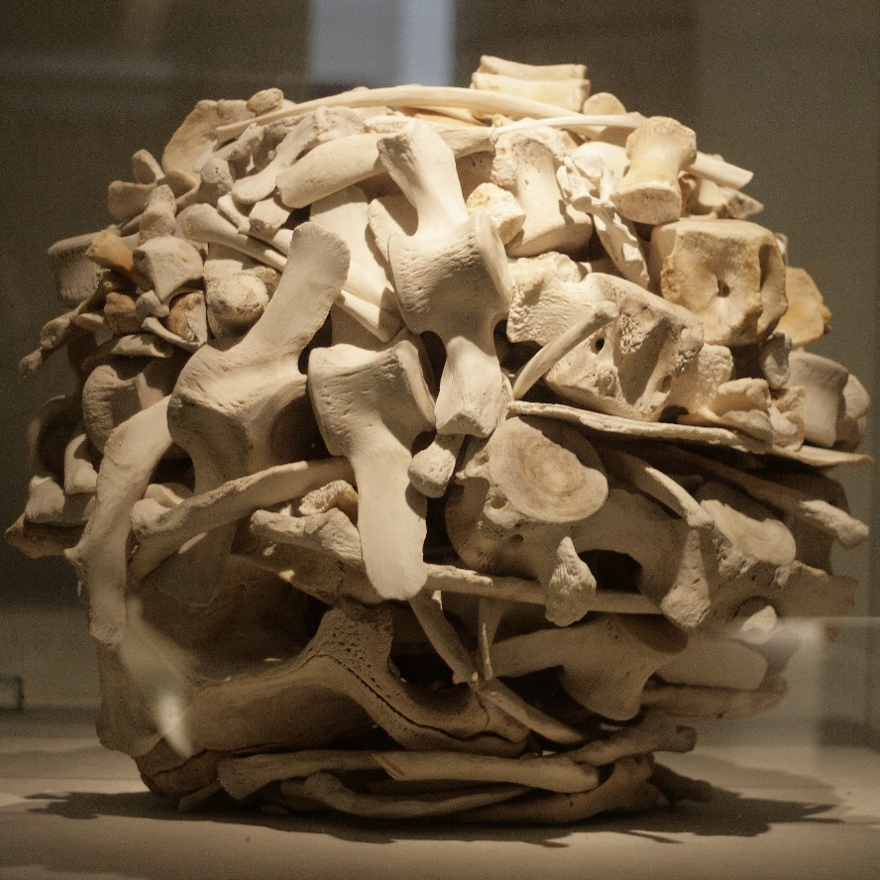
Andy Goldsworthy
This sculpture is made out of whale bones.
Stacked Whalebones,
2001

Slide 9
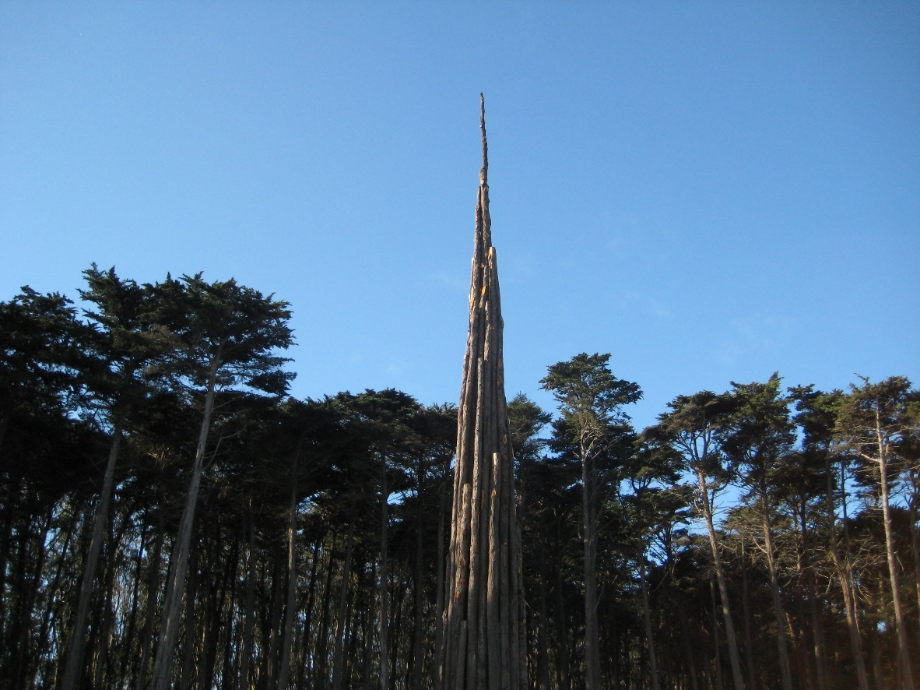
Andy Goldsworthy
This sculpture is made out of wood.
Spire,
2008
Photo courtesy of Moonlightbulb(@flickr.com)-granted under creative commons licence- attribution

Slide 10
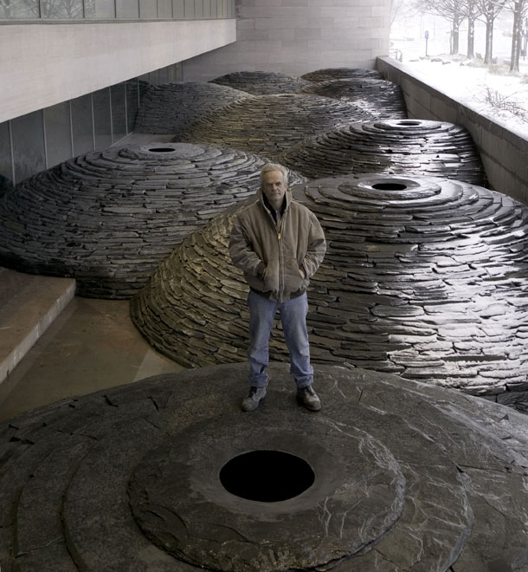
Land Art
Some of Andy Goldsworthy’s sculptures are in museums and galleries.
This is Andy Goldsworthy with one of his sculptures.

Slide 11
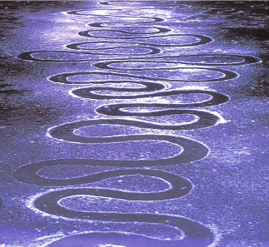
Land Art
Sometimes, Andy Goldsworthy makes sculptures outside.
Often these won’t last forever.
The weather will wash them away.
The natural material they are made from will become part of the landscape.
This is called
Land Art.
Photo courtesy of Moonlightbulb(@flickr.com)-granted under creative commons licence- attribution

Slide 12

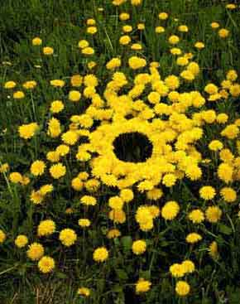

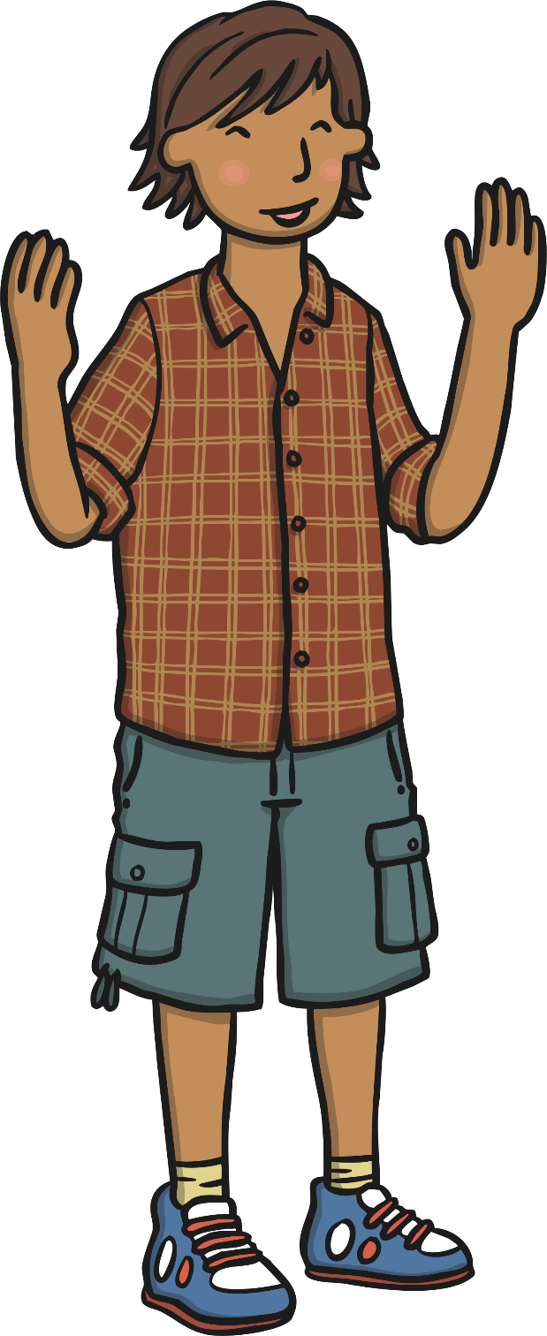
Land Art
What is this land art sculpture made from?

Slide 13
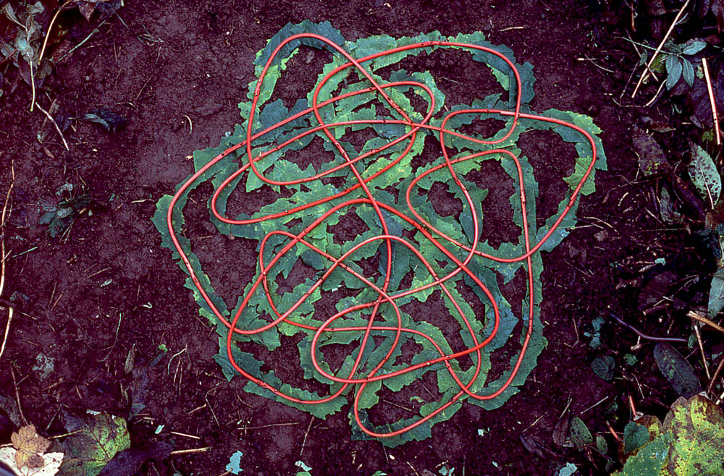


Land Art
What is this land art sculpture made from?

Slide 14
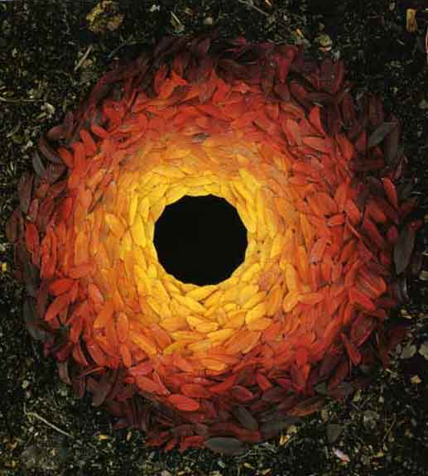


Land Art
What is this land art sculpture made from?

Slide 15
Challenge Activities
Collect your resources.
First you need to collect lots of different natural materials from your local environment. These could be: leaves, twigs, pebbles, feathers, fallen blossom petals, selected wild weed flowers – daisies, dandelions, buttercups etc.
You will need these to create the ‘Art Challenges’ I have set you.
Other resources you will need:
Coloured paints.
Coloured pencils or crayons or chalks.
Glue
Paper
Masking tape.
Tin foil.
String or ribbon or long scraps of material.
Flour-paste – plain flour mixed with water to make a thick sticky batter.
Flour, sugar or rice.

Slide 16
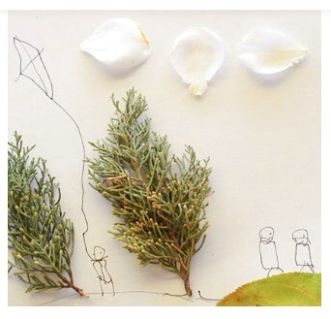
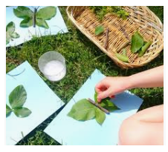
Challenge Activities
Drawing / Collage
You can use flour- paste or PVA glue to join selected natural materials to create insects such as butterflies or arrange materials to create a regular or irregular patterns.
You can draw a picture and select / attach some of your found natural materials to create trees, clouds, just like the example picture here.

Slide 17
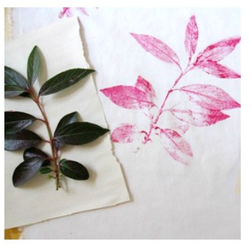
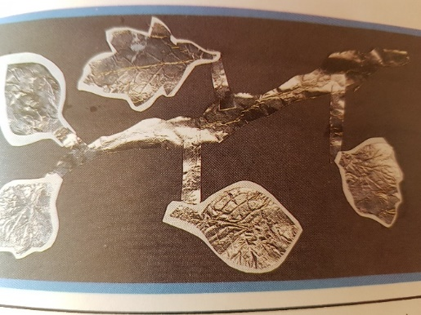
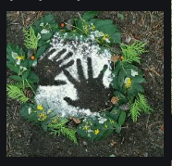
Challenge Activities
Printing / Rubbing
Relief
If you have paints at home, try carefully painting over leaves and then pressing paint side down onto paper or onto the pavement out side. Remember to photograph your artwork.
If you have tin foil at home, try placing your found natural materials underneath and then gently rubbing over the top of the foil until all of the texture patterns of the materials show.
You can then cut each shape out and glue onto paper or use to decorate your main land-art.
If you have flour, sugar or rice at home, you could arrange natural materials or even place your own hand or foot on the ground and then sprinkle over with the flour, sugar or rice. Remove your hand, foot or placed natural materials to reveal relief outline patterns.
Remember to photograph your artwork.

Slide 18
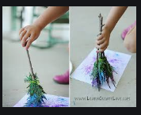
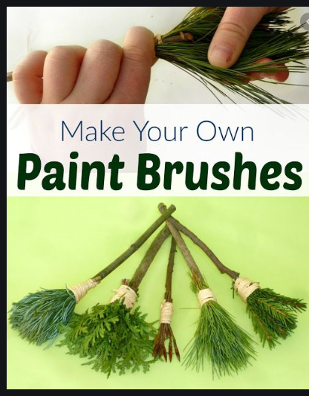
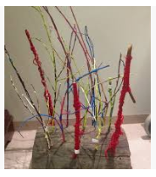
Challenge Activities
Painting
If you have paint at home, try making your own paint brushes from natural materials and then create patterns on paper or better still on the pavement or ground.
Remember to photograph your artwork.
If you have paint at home, try painting twigs, sticks, or pebbles and arrange to make a sculpture.
Remember to photograph your artwork.

Slide 19
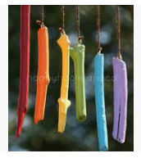
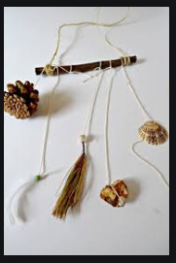
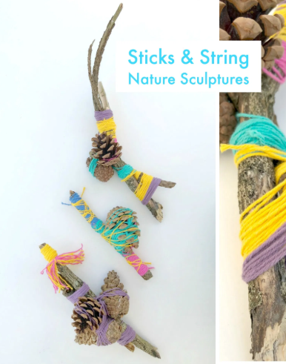
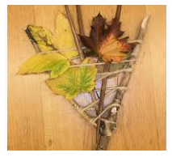
Challenge Activities
Stick & Kinetic Sculptures – moving sculptures.
Nature Weaves.
If you have string, wool or ribbon at home, you can tie around selected natural materials and attach to a twig or stick to make a moving sculpture.
These would look great hanging outside or combined within your main piece of land artwork or join twigs together with string or wool and weave leaves, feathers, grasses within.
Remember to photograph your artwork.

Slide 20
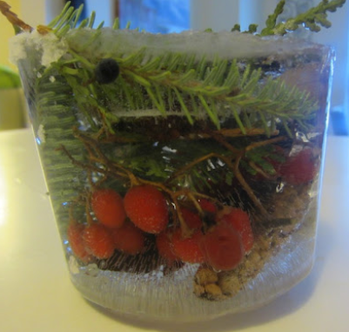
Challenge Activities
Ice Sculpture
If you have a container or a plastic food seal bag, you can arrange selected found materials within the container or plastic food bag and then pour over water to cover all of the materials. Place into the freezer over night.
When completely frozen, remove form container or bag and place your ‘Ice Sculpture’ outside in an interesting place.
Take several photographs from different viewpoints.
Allow your ‘Ice Sculpture’ to naturally defrost.
Return to see how the arrangement of your natural materials now look – do not touch or re-arrange anything.
Photograph your artwork.

Slide 21

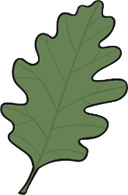


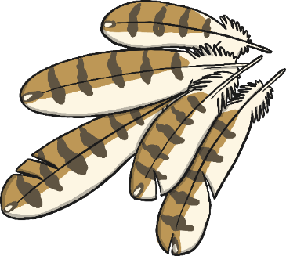

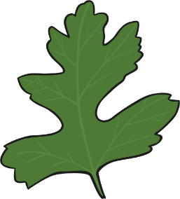
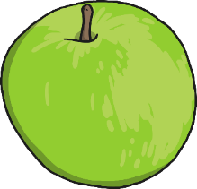

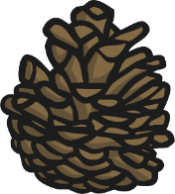
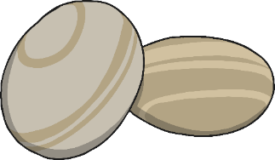
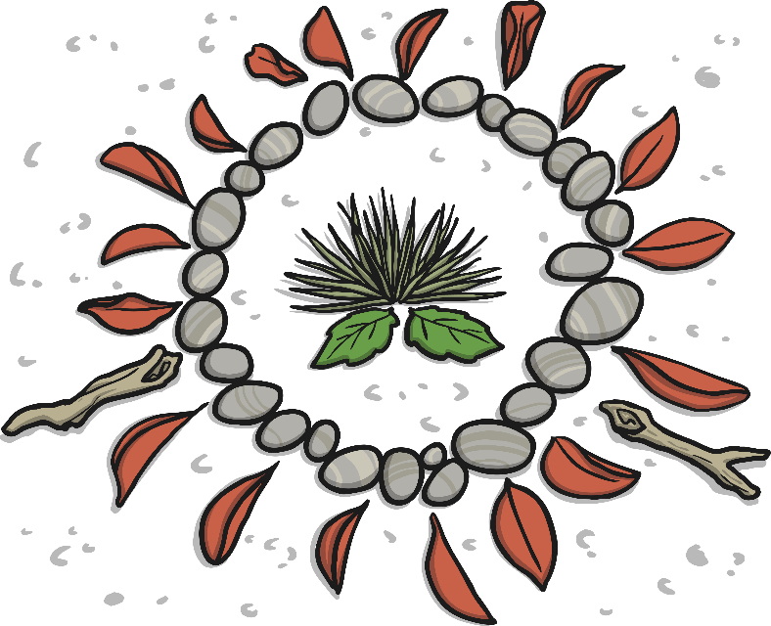
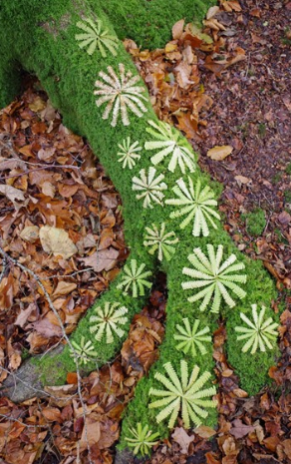
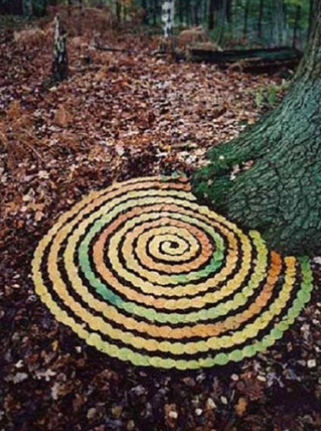
Main Art Activity-
Land Art
You are now ready to arrange your natural materials to make land art sculptures like Andy Goldsworthy.
You can create this in your own garden.

Slide 22
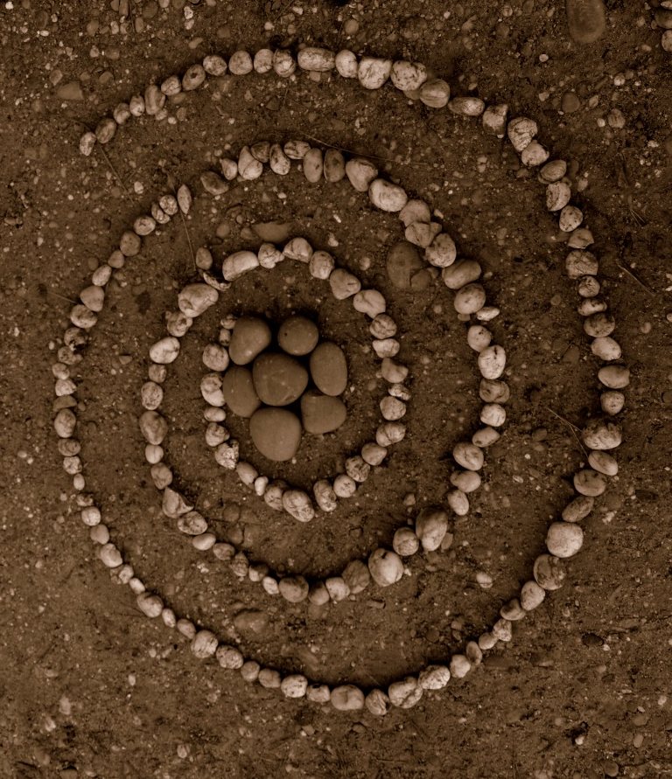
Land Art
This land art is made from pebbles.

Slide 23
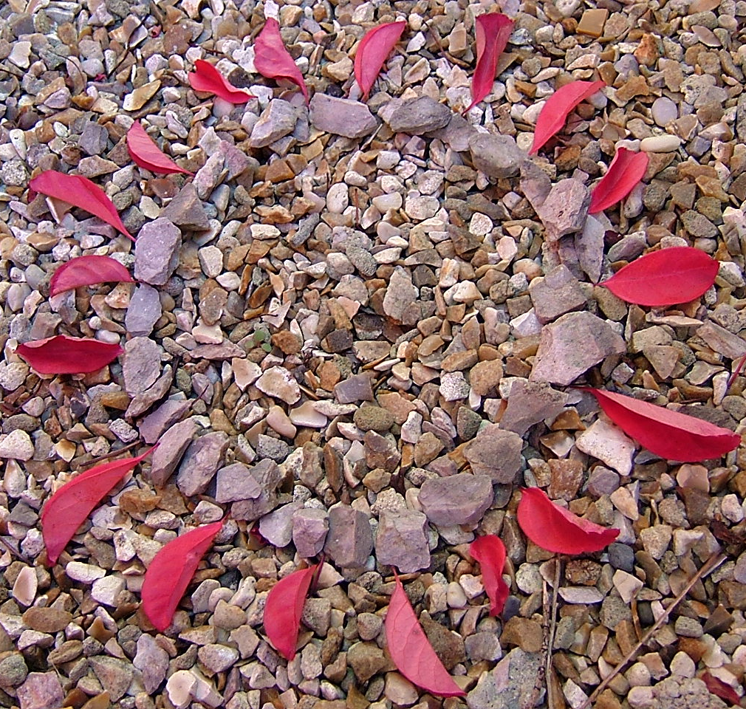
Land Art
This land art is made from leaves and stones.

Slide 24
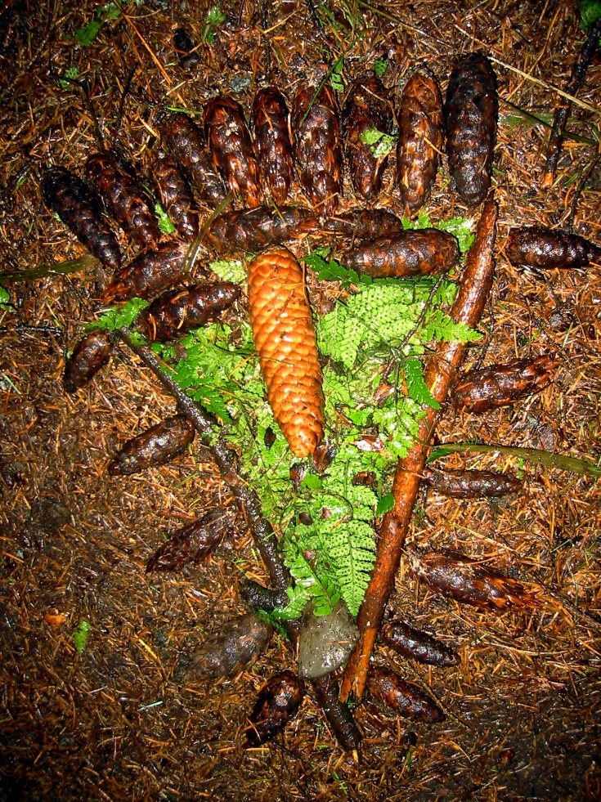
Land Art
This land
art is made from leaves, twigs and pine cones.

Slide 25


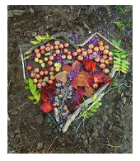
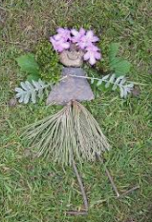

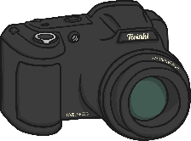
Making Land Art
You will need…
Working on your own or with the help of your family members, you are going to use natural materials to make land art outside.
Arrange your materials to make a pattern or picture that you like. Think about the colours you are using. Think about the shape. Think about the works of Andy Goldsworthy.
Use flour- paste to stick your materials to the ground if it is windy.
You can add your other pieces of challenge artwork here too by placing them near or within the land art arrangement you have created.
When you are finished, take some photographs!
Your land art will last a little while and then it will wash away.
Natural materials
Flour paste, only if it is windy outdoors.
Camera

Slide 26

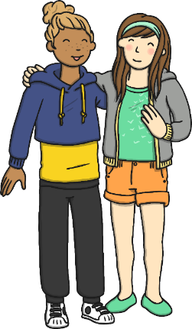
Share
If you completed your land art on your own, invite your home family members to come and see.
Tell them all about it.
You could even send photographs of your finished work to family and friends who you can’t visit at the moment or even face time them and show and tell your work. I am sure they will love seeing and hearing all about it.
Good luck and enjoy making.
Here are some questions for you to ask your child to help them talk about their work.
What shape is it?
What colours did you use?
What materials was it made from?
How did you make it?
What would you do to improve it?
What do you like most about it?

Slide 27
Success Criteria
If you wish, you can talk these through with your child and tick off.
I can choose natural materials for my land art sculpture.
I can choose how I want to arrange my sculpture.
I can arrange my materials carefully to make land art.
I can tell you an interesting fact about Andy Goldsworthy.
I can tell you something about Andy Goldsworthy’s nature sculptures.
Well done - I hope you have enjoyed learning about Andy Goldsworthy and creating land art. I look forward to seeing your wonderful photographs. See you soon.
God bless
Mrs Limer

